Slide 1

ECHR Article 8
LL5532X Law, Algorithms, and Artificial Intelligence
Amanda Lim | Nicha Nutchayangkul | Rini Pinasthika | Sophie Lin
Apr 2026
Notes:
Good evening, today we will share our analysis of ECHR Article 8. Our objective is to test the limits of AI and predictive algorithms in human rights law.

Slide 2

Agenda
01
Context & Significance (Article 8)
02
Dataset Overview
03
Methodology & Four Research Questions
04
Final Conclusions
Notes:
I will start by setting up the legal context of Article 8, walk you through our dataset, and then cover our methodology and our first research question. After that, my teammates will take you through our thematic clustering, cross-regional tests, and our final conclusions.

Slide 3

ECHR Article 8: Scope & Context
Definition
Right to respect for private and family life, home, and correspondence
Exceptions allow states to interfere if "necessary in a democratic society" (e.g., national security)
Research Motivation
Forces Court to balance individual freedom against state interests → rich and diverse text for NLP
Judgments contain both rights text and state justification
2010-2023 Temporal Scope
Historical Context
1950s
1980s
1998
2000s
2010
2022
ECHR Drafted
Influx of Eastern / Central Europe states
Protocol 11
Post 9/11 surveillance
Article 8 applied to digital spaces
Russia expelled from CoE
Project Objective
To apply Natural Language Processing (NLP) and machine learning to decode the structural, geographic, and semantic nuances of ECHR Article 8 jurisprudence, testing the limits of text-based predictive algorithms in human rights law.
Notes:
Let’s start with the law itself. Article 8 protects the right to private and family life. But the crucial part is that it’s a 'qualified' right. That means a state can legally interfere someone’s privacy, but only if they can prove it was 'necessary in a democratic society' for things such as national security. This constant balancing act between individual freedom and state interest. It’s also a law that’s application has changed over time and highly nuanced by geography. This makes Article 8 rich for analysis

Slide 4
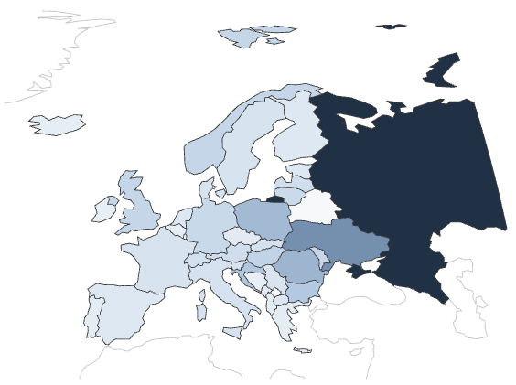
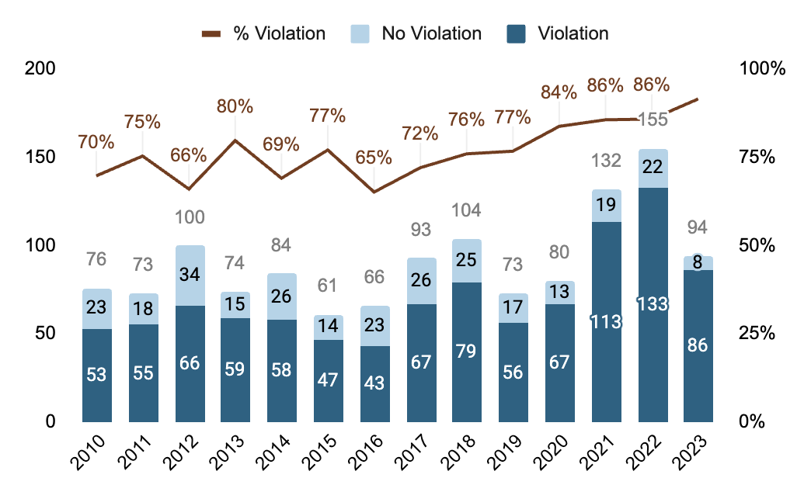

1,265 Cases Between 2010 and 2023 | 78% Violation
Limitation:
Admissibility filter creates a severe survivor bias in the dataset - the model is only learning from the hardest, pre-screened cases
Limitation:
The single largest country, Russia, accounts for 27% of cases at a 94% violation rate, causing structural overfitting to geographic bias
During preprocessing, 56 cases flagged as "Only Mentioning" were explicitly filtered out of the dataset (judgments that were settled via Just Satisfaction or struck out without a substantive ruling on the merits)
Notes:
Let’s look at our dataset. We have 1,265 cases decided between 2010 and 2023. The first thing that jumps out is the class imbalance.
78% of these cases end with the Court finding a violation against the state. We want to be clear that this is not a sampling error. The ECHR has a strict admissibility filter. Similar to supreme court cert petitions, they weed out the vast majority of weak cases before they ever get a full written judgment. This creates a severe survivor bias in our data. By the time a case is published, the state is already on the defensive.

Slide 5
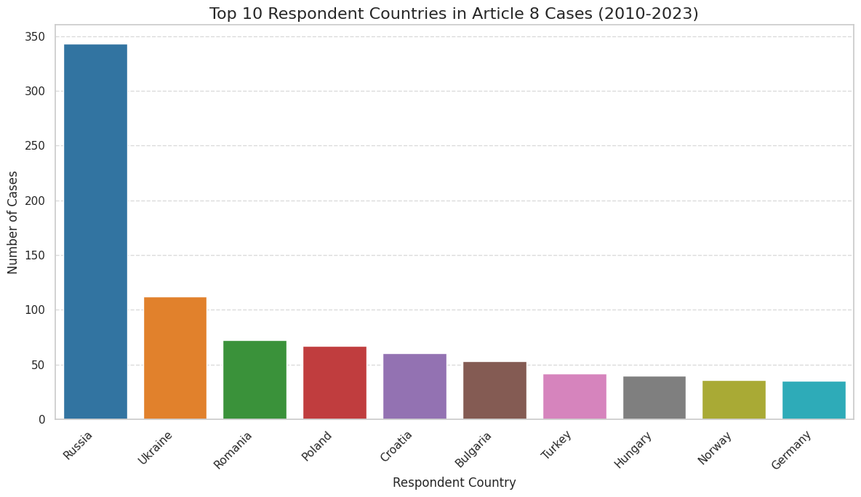
Russia Accounts for 27% of all Cases, 94% are Violations
342 Russian cases dominate the dataset, more than double the number of Ukraine cases
Near-universal violation rate means any model partially learns "Russia = violation" rather than learning legal reasoning
This is not a legal finding about Russia — it is a structural warning about what the model will actually learn.
Notes:
We also have a massive geographic outlier in our data. Russia alone accounts for 27% of all cases, and they lose 94% of the time.
To put that in perspective, we have more than double the number of Russian cases compared to Ukraine. As we’ll see later, this volume of near-guaranteed violations acts as a massive statistical bias

Slide 6
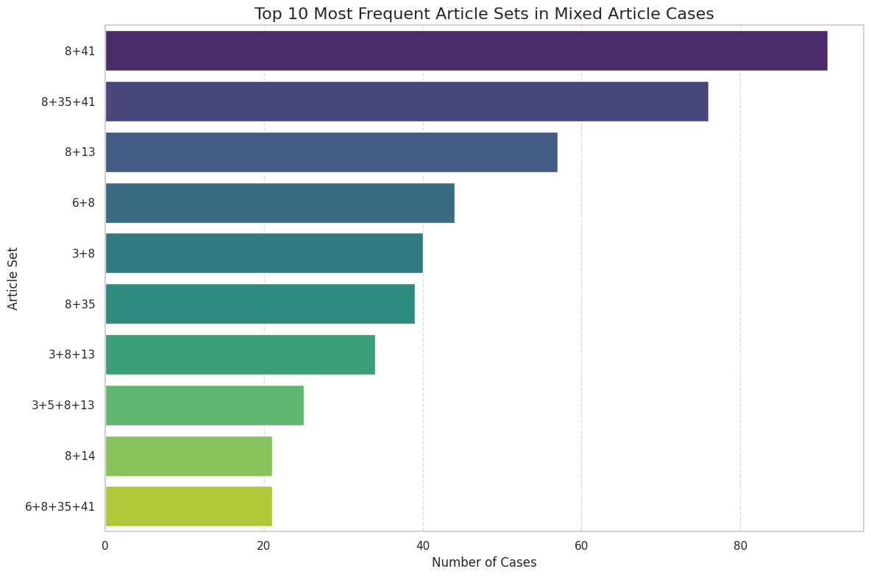
A Problem Hidden in the Document Structure
Top article pairings are 8+41 (91 cases) and 8+35+41 (76 cases)
Article 41 awards just satisfaction (damages and costs) and is structurally absent from no-violation judgments
Before any model is trained, the document itself already encodes the outcome through its remedy language
This is the leakage problem, discovered at EDA stage
Notes:
During our EDA, we uncovered a structural trap. We noticed that Article 8 is frequently paired with Art 41. Art 41 is the provision that awards 'just satisfaction' meaning damages and legal costs to the applicant. Crucially, Article 41 is only ever applied when the state loses. It is structurally absent from judgments where there is no violation. This creates a massive linguistic giveaway hidden right in the document structure.

Slide 7
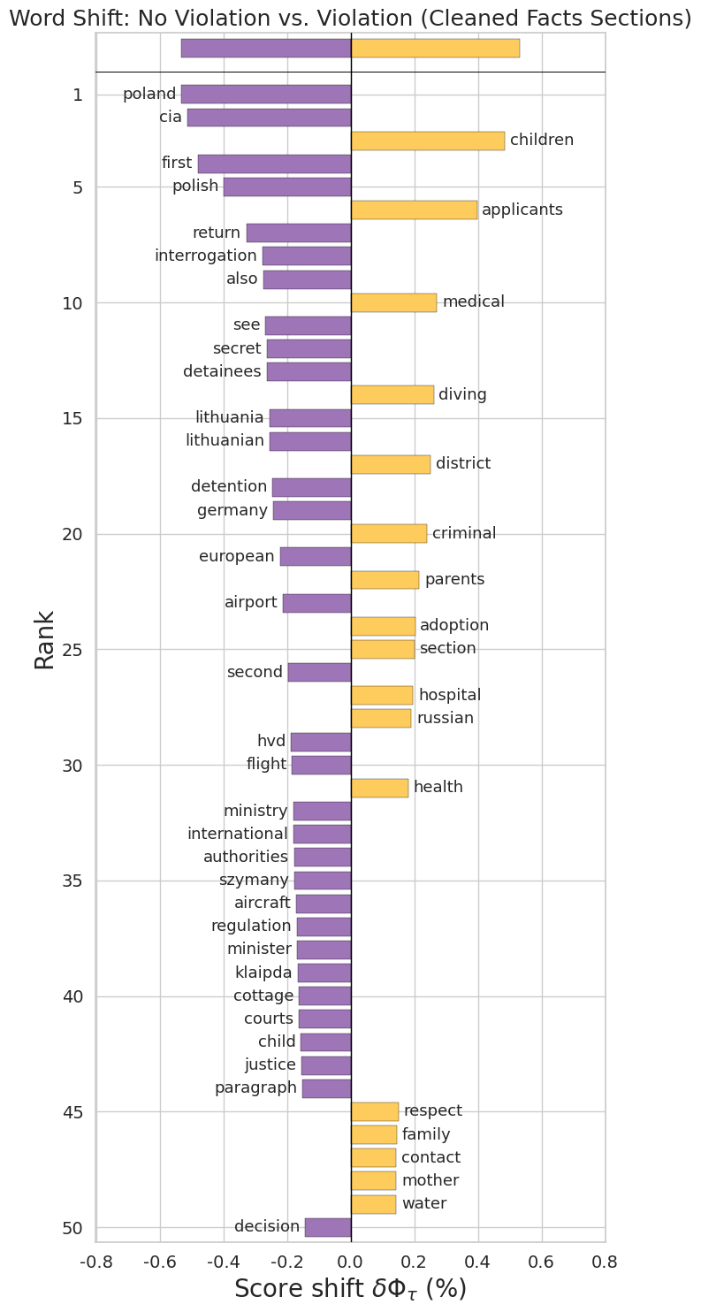
What Separates Violation from No Violation?
Facts Section
Violation: Coercive state vocabulary (detention, surveillance, seizure, expulsion).
No Violation: Procedural and domestic remedy language.
Law Section
Dominated by Article 41 terms (costs, expenses, pecuniary, awarded) rather than substantive legal reasoning.
ScatterText and Shifterator analyses both confirm the same pattern independently.
Notes:
We also looked at the word shift in the judgments. We found that cases resulting in a violation heavily feature coercive state vocabulary like detention, surveillance, and seizure.
On the opposite side, cases where the state wins tend to feature heavily procedural language regarding domestic remedies.
This confirmed to us that the narrative of a case can carry a genuine predictive signal.

Slide 8
How EDA Informed Our Modeling Approach
Macro F1 over accuracy
A dummy classifier predicting violation every time achieves 78% accuracy.
Macro F1 holds the model equally accountable for both classes.
Test law and facts separately
They carry fundamentally different signals.
Combining them without understanding each would obscure the leakage problem.
Treat respondent country as a bias risk
Including it as a feature imports Russia's violation rate into every prediction.
The goal is learning transferable legal reasoning, not local bias.
Custom stop word list
EDA identified universal terms vs. discriminative signal (necessary, margin).
Design driven by Shifterator and ScatterText.
Notes:
Our exploratory data analysis ultimately gave us four clear directives for our modeling. First, because of that massive 78 percent violation rate, our EDA told us that raw accuracy is a dangerous trap. Think about it: if a dummy classifier blindly guesses 'Violation' every single time, it hits nearly 78 percent accuracy on our dataset without reading a single word. That is why we committed to using Macro F1, which mathematically penalizes the model for ignoring the minority class. [Pause]
Second, the geographic data warned us about severe overrepresentation. We knew we had to watch out for the 'Russia effect' where the sheer volume of Russian losses might override the actual textual nuances of the law.
Third, we spotted those major linguistic giveaways tied to Article 41 'just satisfaction' awards. This told us right away that lexical cleaning was going to be absolutely necessary if we wanted to isolate genuine legal reasoning from structural boilerplate. [Pause]
And finally, our word shift graphs proved that there is a real signal hidden in the case facts. The narrative text carries its own predictive weight, which is exactly why we set up our experiment to test the Facts section completely independently from the Law section.

Slide 9

Framing the Research Questions
Core Question
Can a machine learning model learn legal reasoning, or does it merely capture structural artifacts and localized vocabulary?
RQ1: Can we predict outcomes?
Yes, but the model learned country, not law.
RQ2: What are the dominant themes in Article 8?
Four dominant thematic clusters identified
RQ3: Does the model generalize across regions?
No, crossing borders collapses performance.
RQ4: Do concepts share meaning across regions?
Same words, different functions.
Key Assumption: ECHR judgements contain sufficient linguistic signal to predict outcome - if they do not, that is itself a legally meaningful finding about the indeterminacy of Article 8 reasoning
Notes:
We built four research questions. RQ1 tests if the text beats the metadata. RQ2 clusters the dominant legal themes. RQ3 tests if the law generalizes across borders. And RQ4 tracks the semantic drift of the legal vocabulary itself.

Slide 10
Methodological Foundations & Model Logic
The Metric Choice: Macro F1 over Accuracy
78% violation rate makes Accuracy flawed. A "dummy classifier" would hit 78% but fail on "No Violation" classes. We prioritize Macro F1 to penalize majority-class bias and hold the model accountable for both classes.
Algorithm Choices
Imbalance Handling
Utilized balanced class weights during training for all models.
Applied SMOTE only for metadata and topic features. Avoided for high-dimensional raw text to prevent overfitting.
TF-IDF
Logistic Reg. & SVM
NMF
Naive Bayes
Word2Vec & t-SNE
RQ1, RQ3
RQ1-3
RQ2
RQ2
RQ4
Represents each judgement as a vector of term weights, legally distinctive vocabulary more visible
Core predictive models. Linear boundaries allow extraction of feature weights to drive violation findings.
Compressed TF-IDF into 40 interpretable topic clusters (e.g., state surveillance, child welfare).
Comparative baseline. Lower performance confirms topic weights are correlated, breaking independence.
Captured context and semantic neighborhoods to visualize doctrinal meaning shifts across regions.
Notes:
Just to reiterate our methodological foundation before we show the results: we evaluate all our models using Macro F1 and balanced class weights. This ensures our model is held equally accountable for predicting both state victories and state violations.
TF-IDF (Textual Salience): Deployed first to translate the raw ECHR judgment text into a numerical "Bag-of-Words" matrix, assigning high mathematical importance to distinctive legal vocabulary (appearing frequently in that case but rarely across the corpus) while filtering out generic stopwords.
Logistic Regression & SVM (Primary Classifiers): Used as our core predictive models across the experiment. Because they construct linear decision boundaries, they allow us to extract feature weights to see exactly which textual themes or metadata variables drive the Court's violation findings.
NMF (Latent Themes): Deployed in RQ2 to compress the massive TF-IDF matrix into 40 interpretable topic clusters. This shifted our model from tracking specific vocabulary to tracking high-level legal themes (e.g., state surveillance, child welfare).
Naive Bayes (Comparative Baseline): Tested in RQ2 alongside our linear models specifically to demonstrate algorithmic fit. Its lower performance confirms that NMF topic weights are inherently correlated, which breaks Naive Bayes' core assumption of conditional independence.
Word2Vec & t-SNE (Semantic Drift): Introduced in RQ4. While TF-IDF captures word frequency, Word2Vec was used to capture context. By mapping semantic neighborhoods, it allowed us to visualize how the exact same doctrinal vocabulary (e.g., "margin," "necessary") takes on entirely different legal meanings depending on the region.

Slide 11
RQ1: Baseline Outcome Prediction
The Question
Does case text provide a stronger predictive signal for Article 8 outcomes than structured metadata?
Three-arm Experiment Design
Text Variants
V1 Facts: what happened to the applicant
Pre-decision narrative. No outcome-encoding language, provides the most text signal.
V2 Law Full: The Court’s full reasoning
Includes Art 41 “just satisfaction” language found in violation judgements - potential leakage.
V3 Law Clean: Reasoning with Remedies Stripped
Remedies vocabulary removed. Tests whether leakage is lexical or structural.
Metadata Only
Country, year, court formation, importance level, dissent flag
Text (Three Variants)
V1 Facts, V2 Law Full, V3 Law Clean
Metadata + Text
Do the two sources complement or conflict?
Notes:
So, let us dive into RQ1. We wanted to know if the actual text of a judgment provides a stronger predictive signal than structural case metadata.
To test this fairly, we set up a three-arm experiment.
Arm 1 uses only metadata.
Arm 2 uses only the text.
And for the text arm, we made three variants: the Facts section alone, the full Law section, and a 'Cleaned' Law section.
Finally, Arm 3 combines the text and the metadata into one single pipeline.

Slide 12
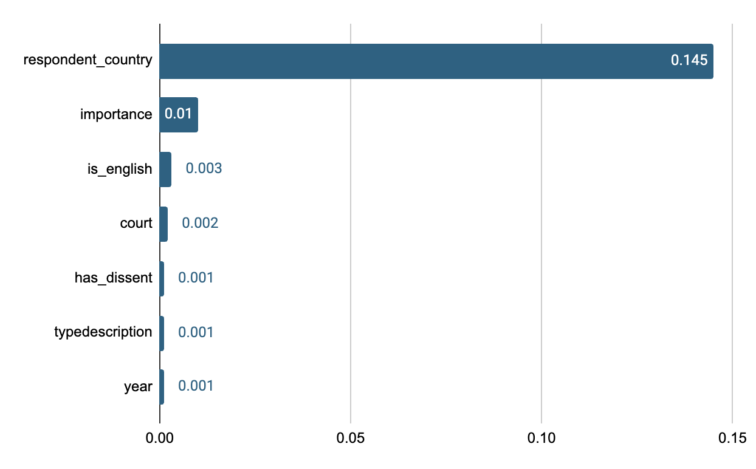
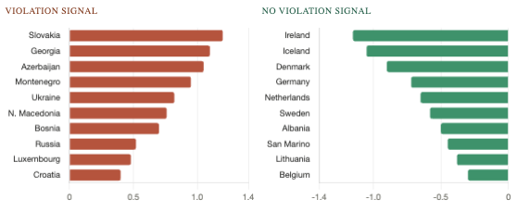
RQ1: Metadata - The Algorithm Learned Geography, not Law
Feature importance (permutation, macro F1)
Country coefficients — violation predictors
LinearSVC averaged coefficients · single-country cases only
Small-sample distortion: Slovakia, Georgia, Azerbaijan show 100% violation rates but only 2–20 cases each.
Their extreme coefficients reflect data sparsity, not genuine legal patterns.
respondent_country carries ~10x the importance of every other feature combined
The model is not learning Article 8 law, it learned which states tend to lose
Notes:
Let us look at Arm 1. Our metadata-only model hit an F1 score of about 0.65. When we checked the feature importance, we found the algorithm was essentially just learning geography. The 'respondent country' feature carried almost ten times the weight of any other variable. The model was not learning Article 8 law at all. It just learned the historical fact that Russia and similar states usually lose.

Slide 13
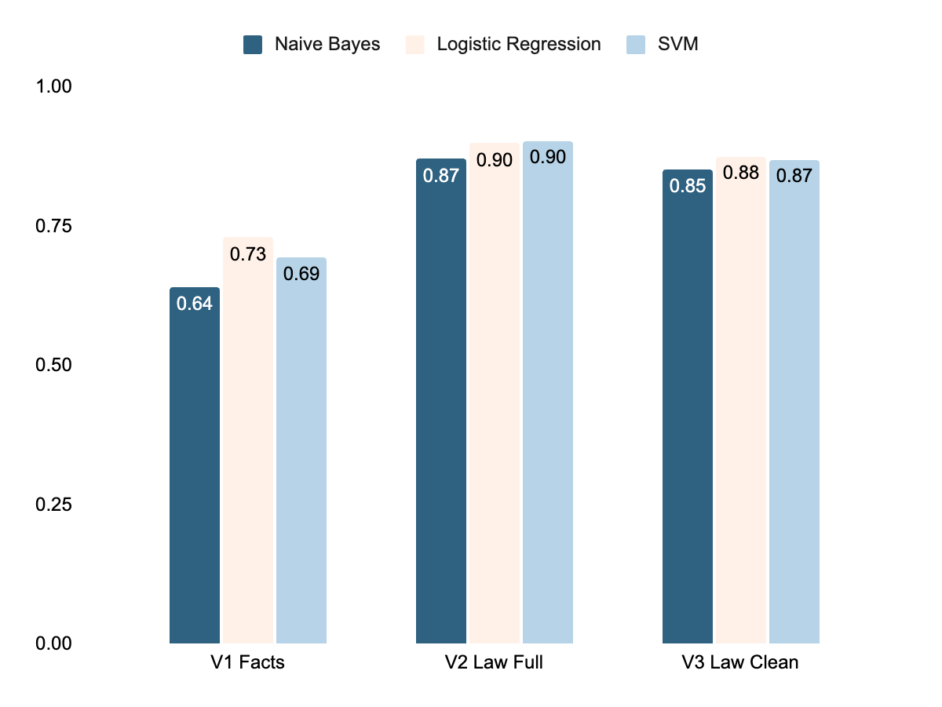
RQ1: Text beats metadata, but the Law section's lead hides a problem
Macro F1 by Text Variant x Classifier
SVM Performance Analysis
V1 Facts: 0.694
Upper Bound - no outcome-encoding language in the facts section.
V3 Law Clean: 0.870
+0.221 over metadata. Remedies stripped. Leakage persists — structural, not lexical.
V2 Law Full: 0.904
Highest score — but inflated by Article 41 "just satisfaction" boilerplate present only in violation judgments.
Notes:
Moving to Arm 2, the text outperformed the metadata. Our V1 Facts section hit a 0.69, which is a very honest predictive signal. But our V2 Full Law section hit a 0.90 Macro F1 score. However, that 0.90 is completely inflated by the Article 41 'just satisfaction' boilerplate we discussed earlier.

Slide 14
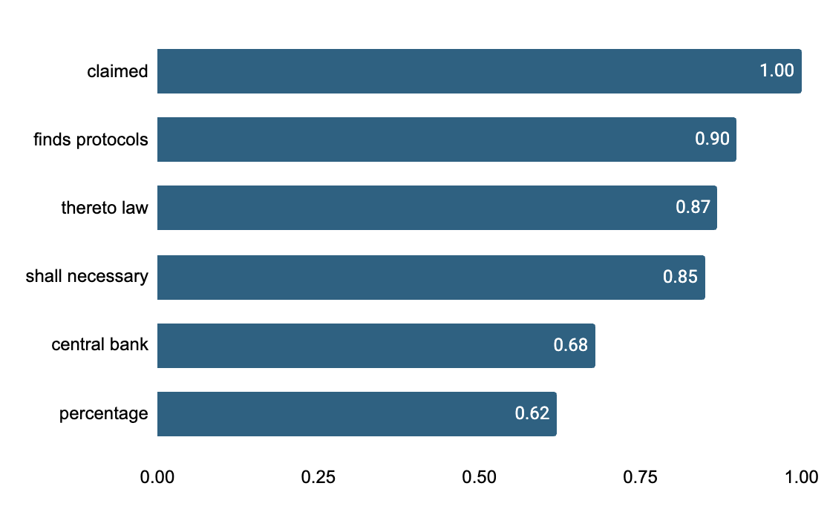
RQ1: Arm 2 Leakage
V1 - Facts (SVM)
V2 — Law Full (SVM)
V3 — Law Clean (SVM)
Predic ->
No Viol
Violat
Predic ->
No Viol
Violat
Predic ->
No Viol
Violat
No Viol
0.35
0.65
No Viol
0.83
0.17
No Viol
0.74
0.26
Violat
0.05
0.95
Violat
0.04
0.96
Violat
0.04
0.96
Only 35% of No Violation cases correctly identified. The factual narrative alone cannot distinguish restraint from intervention. But this is the most honest signal.
No violation recall jumps to 83%. But the model is detecting just satisfaction language present only in violation judgments.
No violation recall drops from 83% to 74% after cleaning. Residual leakage remains.
Why cleaning fails: the leakage is structural
Top V3 Law Clean violation predictors
Article 41 awards just satisfaction only when a violation is found. Its boilerplate text generates hundreds of discriminative n-gram features from a small number of fixed sentences.
Lexical cleaning cannot solve a structural problem. The only fix is paragraph-level excision before feature extraction.
These are Article 41 fragments, not legal reasoning.
V1 Facts top predictor "independence" — surveillance oversight. Much more substantive.
Notes:
We tried to fix this structural flaw with our V3 'Law Clean' variant. We explicitly filtered out all the remedy words. But looking at our confusion matrices, the No Violation recall dropped, and the overall score stayed artificially high at 0.87. We realized that lexical cleaning cannot fix a structural problem. The algorithm simply found secondary leakage words to rely on. The only way to truly predict legal reasoning is to perform paragraph-level excision before you extract any features.

Slide 15
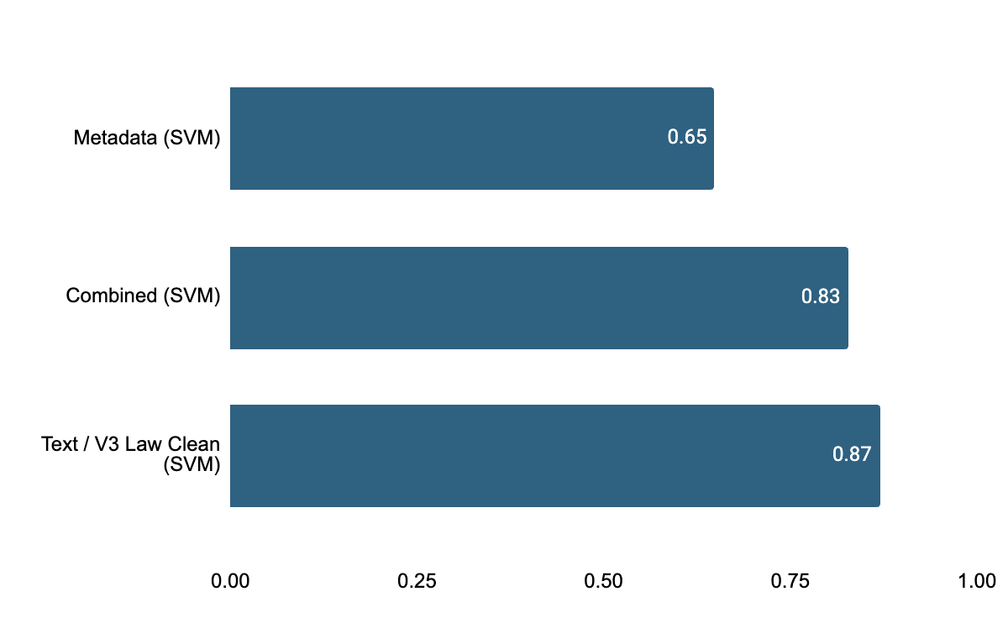
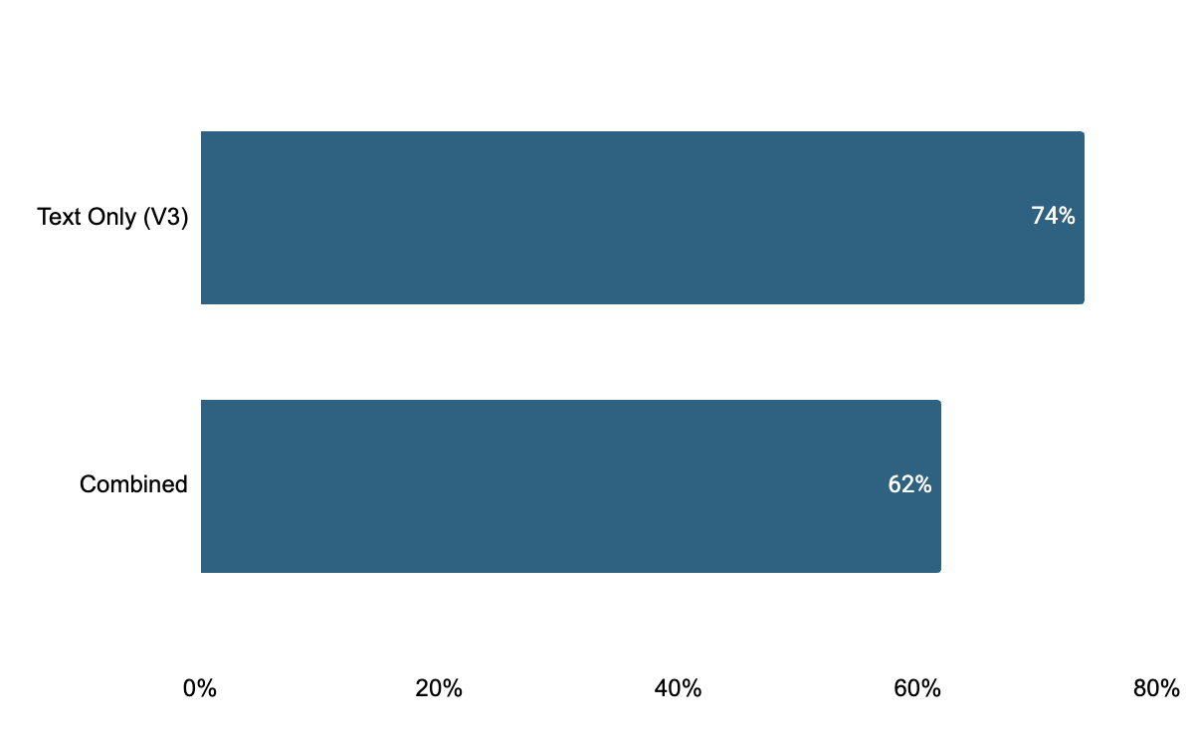
RQ1: Arm 3 - Adding metadata to text makes the model worse, not better
The respondent state feature imports systematic bias that suppresses no-violation recall
Three-arm macro F1 comparison (SVM)
Expected: Combined > Text > Metadata. Actual: the opposite of expected.
Why does adding metadata hurt?
The Russia problem
Russia accounts for 27% of the dataset at a 93.6% violation rate. When respondent_country is included, the model learns a strong prior: Russian case → almost certainly violation.
The override mechanism
This country-level prior overrides the text model's nuanced no-violation signal for high-violation-rate states — even when the textual evidence points toward no violation. The result: violation recall rises marginally (96→97%) but no-violation recall collapses (74→62%).
Where performance drops: no-violation recall
Violation Recall (Combined)
97%
The implication
Metadata is not uninformative (F1 0.649 beats chance). But its dominant signal — respondent state — amplifies class imbalance rather than correcting for it. A geographically balanced dataset would likely produce the expected complementary result.
No Violation Recall (Combined)
62%
No violation recall — adding metadata costs 12 percentage points
Notes:
For Arm 3, we hypothesized that combining text and metadata would give us the best of both worlds, but we were wrong. Adding metadata actually made the model perform worse, dropping the score down to 0.82.
This is the 'Russia Problem' overriding the text. When we fed the model geographic metadata, that giant country-level bias impacted the algorithm. The model started blindly guessing 'Violation' for high-rate states, and its ability to accurately predict 'No Violation' cases completely collapsed from 74% down to 62%

Slide 16
RQ1: Text Beats Metadata, but the reason is surprising
Metadata Baseline
0.649
The model learned geography. respondent_country alone accounts for ~10× the signal of all other features.
Three limitations to carry forward
Article 41 leakage is structural, not lexical. Paragraph-level excision is required for clean analysis.
No Violation paradox. Same vocabulary used for different outcomes — the limit of bag-of-words.
Russia overfitting. 27% cases at 93.6% violation rate creates predictive shortcuts.
V1 Facts
0.694
+0.045 over metadata. No leakage risk. The factual narrative alone carries genuine predictive signal beyond geography.
V3 Law Clean
0.870
+0.221 over metadata. Leakage persists structurally. Best usable law-section estimate.
What this leads us to ask
Which topics drive violations by region? — RQ2 NMF clustering.
Are legal battlegrounds genuinely different? — RQ3 generalisation.
Does "margin of appreciation" mean the same thing? — RQ4 semantic drift.
Combined
0.828
Worse than text alone. Imports Russia's base rate and suppresses recall from 74% → 62%.
Notes:
To wrap up RQ1, we carry three major limitations forward.
Article 41 leakage is structural and requires paragraph-level excision.
There is a 'No Violation' paradox where the vocabulary of human rights protection is exactly the same as the vocabulary of judicial restraint, which exposes the limits of a bag-of-words approach.
Geographic imbalance creates dangerous predictive shortcuts.
These flaws force us to ask deeper questions. What topics actually drive these violations? And are the legal battlegrounds genuinely different across regions? To answer that, I will hand it over to Nicha to walk you through RQ2

Slide 17
RQ2: Topic Clustering
The Question
What are the dominant themes in Article 8 cases between 2010 and 2023?
Hypothesis
If the corpus has identifiable thematic clusters those clusters should also carry predictive signal.
Why do we want to know?
Article 8 covers a wide range of disputes from state surveillance and secret detention to child custody, data protection, and housing eviction.
If these share no common legal structure then outcomes are driven by the specific facts of each sub-area rather than any consistent doctrinal principle. But if coherent themes exist with consistent outcome patterns, it suggests Court is applying a recognisable and transferable legal standard across Article 8.
Notes:
Article 8 covers an unusually wide range of disputes — from state surveillance and secret detention to child custody | data protection | and housing eviction. If these share no common legal structure | then outcomes are driven by the specific facts of each sub-area rather than any consistent doctrinal principle. That would mean a model trained on surveillance cases tells us nothing about family life cases | and a lawyer advising on a data protection claim cannot draw on deportation precedents.
But if coherent themes exist with consistent outcome patterns | it suggests the Court is applying a recognisable and transferable legal standard across Article 8 — and that predictive modelling is a legitimate tool for understanding how that standard operates in practice.

Slide 18
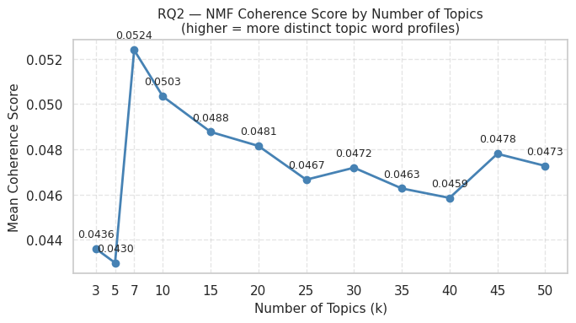
RQ2: Approach - NMF Topic Modelling
Approach
NMF to compress TF-IDF text into 40 latent topics where each document receives a weight for each topic indicating how strongly it belongs to that theme.
Technical Input & Method
Input: Facts and Law Full sections combined
k=40 selection: Based on coherence score curve balancing granularity against topic splintering.
Notes:
If you choose too few | distinct legal themes get merged together into vague | overlapping groups. If you choose too many | coherent themes start splitting into meaningless fragments.
The coherence score measures how interpretable and internally consistent each topic is. We ran NMF across a range of k values and plotted the coherence scores. k=40 was the point where adding more topics stopped producing meaningfully new themes and started producing noise — so we used that as the cutoff.
Looking at the chart | k=7 actually has the highest coherence score (0.0524) | meaning 7 topics produced the most internally distinct and interpretable themes. The score drops after that and never recovers to the same level.
k=40 was a deliberate choice to trade coherence for granularity — 7 topics would have been too coarse to distinguish between | say | surveillance cases and deportation cases | which are legally very different even if they share some vocabulary. The justification should be framed as a conscious trade off rather than an optimal selection:
"k=7 produced the highest coherence but merged legally distinct themes into overly broad clusters. k=40 was chosen to preserve sufficient granularity for legal interpretation | accepting lower coherence in exchange for more specific and actionable topic groupings."

Slide 19
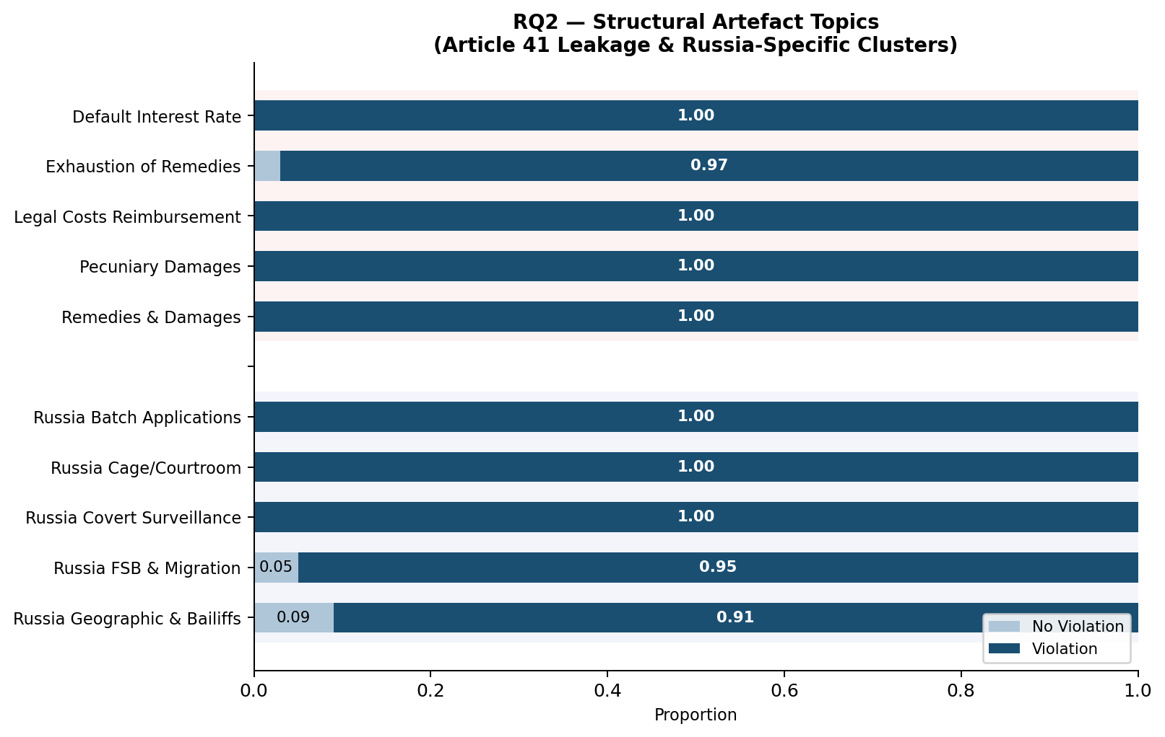
RQ2 – Structural Artefact Topics
Article 41 Leakage
Four topics record 100% violation due to "just satisfaction" language in judgments a structural data contamination issue stop words cannot fix.
Article 41 Leakage
Russia-Specific
Russia-Specific Clustering
Five topics isolate Russian Article 8 cases at 91-100% violation reflecting respondent state concentration rather than generalizable doctrinal patterns.
High violation rates often reflect structural artifacts or specific jurisdiction failures rather than uniform doctrinal trends.

Slide 20
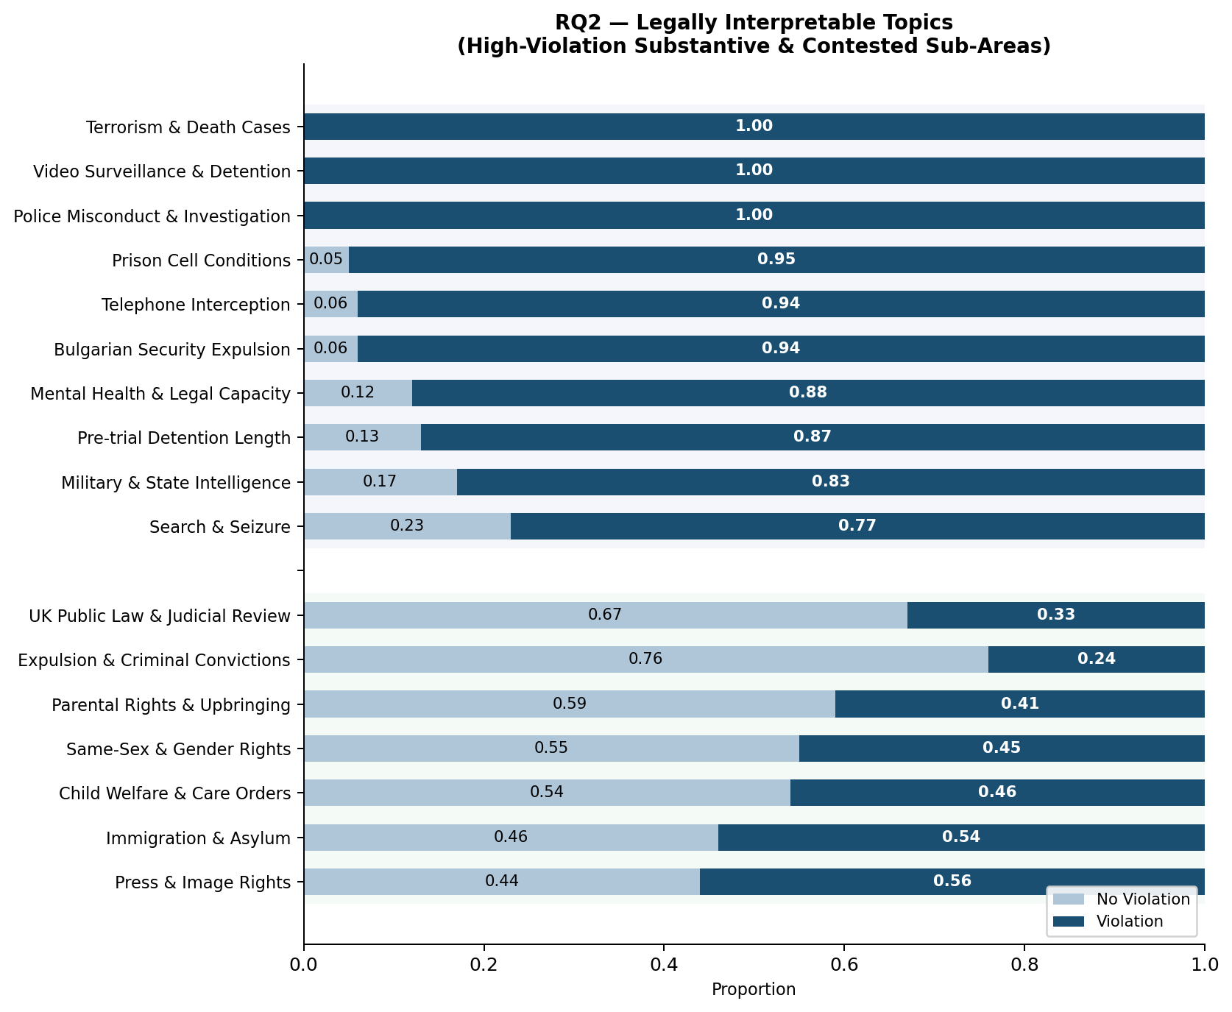
RQ2: Topic-Level Violation Patterns
Surveillance & Coercion
Interception and Police Misconduct sit at 94-100% violation consistent with strict scrutiny under Zakharov and Big Brother Watch.
High-violation substantive topics
Bulgarian Security
94% violation rate captures systematic lack of judicial scrutiny.
Mental Health
88% violation reflects failure to meet proportionality standards in mental health interventions.
Genuinely Contested
Topics near the 50/50 boundary (Same-Sex 55% Child Welfare 54%).
UK Public Law
Highest 67% no-violation rate, UK courts have already applied Convention-compatible analysis.
Genuinely contested topics
Notes:
Mental Health & Legal Capacity: Proportionality Failures
Autonomy Rights: Compulsory treatment and institutionalisation engage the core right to personal autonomy under private life.
Procedural Safeguards: Violations often stem from legal frameworks lacking adequate protection against arbitrariness.
Last Resort Doctrine: Incapacity measures must be grounded in specific medical evidence and used only when no less restrictive alternatives exist.
Key Jurisprudence
X v. Finland (2012): Forced medication and confinement found unlawful due to insufficient procedural safeguards.
Roman Zakharov v. Russia (Grand Chamber, 2015)
the Court found a violation because Russian surveillance law did not provide adequate independent oversight, with judicial and prosecutorial supervision being limited and not open to public scrutiny, such that the very existence of the contested legislation amounted to an interference with Article 8.
Big Brother Watch v. UK (Grand Chamber, 2021)
a violation was found in part because of the absence of independent authorisation of bulk interception and the failure to subject targeted selectors to prior independent review, with the Court reiterating the requirement for end-to-end safeguards including independent oversight at each stage of the surveillance process.
Key contrast for your presentation:
Zakharov = no oversight at entry point. Big Brother Watch = oversight existed on paper but collapsed at the point of use. Same Article 8 violation, structurally different failure — exactly what NMF topic weights cannot distinguish.

Slide 21

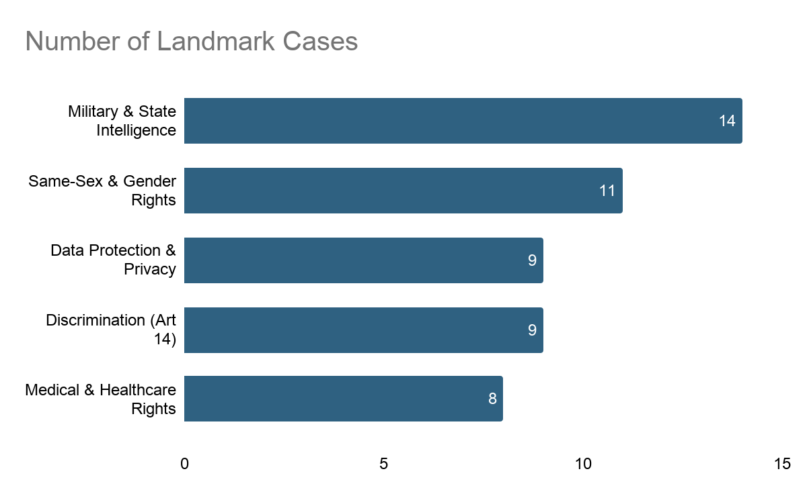


RQ2: Landmark Cases
Modeling Approach
Filtered for Importance Level 1, used NMF argmax to find the mathematical centroid of our top topics.
Landmark Cases
Case
Topic
Significance
Violation
Military & State Intelligence
Detained by Macedonia transferred to CIA held in a secret Afghan facility without charge.
National security cannot shield state conduct with no legal basis
El Masri v. Macedonia
No Violation
Same-Sex & Gender Rights
First time the Court recognised same-sex couples as "family life"
No consensus among member states so wide margin of appreciation.
Schalk and Kopf v. Austria
No Violation
Data Protection & Privacy
Germany required telecom providers to retain all prepaid SIM subscriber data.
Procedural protections were adequate
Breyer v. Germany
“Family life”, “proportionality” and “safeguards” appears in both Schalk and Kopf and Breyer but serves completely different functions. A bag-of-words model cannot tell the difference.
Notes:
El-Masri v. The Former Yugoslav Republic of Macedonia (Military & State Intelligence)
The Legal Landmark: The Court explicitly condemned a European state's complicity in CIA extraordinary rendition | ruling that covert national security operations cannot be used as a blanket shield to bypass human rights scrutiny.
The Modeling Impact (Zero Margin): Because this extreme physical state conduct allows for absolutely zero "margin of appreciation |" it explains why your "Military & State Intelligence" topic is uniformly Violation-dominant. The vocabulary of rendition and secret detention acts as an absolute mathematical signal for a violation.
Schalk and Kopf v. Austria (Same-Sex & Gender Rights)
The Legal Landmark: The Court took a massive progressive step by extending the concept of "family life" to same-sex couples | but simultaneously found no violation by granting Austria a wide margin of appreciation due to a lack of European consensus.
The Modeling Impact (The "No Violation" Paradox): This case perfectly exposes why algorithms struggle with No Violation outcomes. The text is packed with "violation" vocabulary (discrimination | rights | proportionality) | proving that models fail because they cannot detect when the Court is using progressive words to justify judicial restraint rather than intervention.
Breyer v. Germany (Data Protection & Privacy)
The Legal Landmark: The Court found no violation regarding mandatory SIM card data retention | establishing that digital interference is proportionate if the state implements strict | bureaucratic "double-door" safeguards and oversight.
The Modeling Impact (Context vs. Vocabulary): This highlights the ultimate limit of TF-IDF/NMF models. Breyer shares the exact same severe vocabulary (surveillance | interference | privacy) as violation cases like El-Masri | but uses them to validate state administrative procedures rather than condemn them—a distinction only a sentence-level model like BERT could catch.

Slide 22
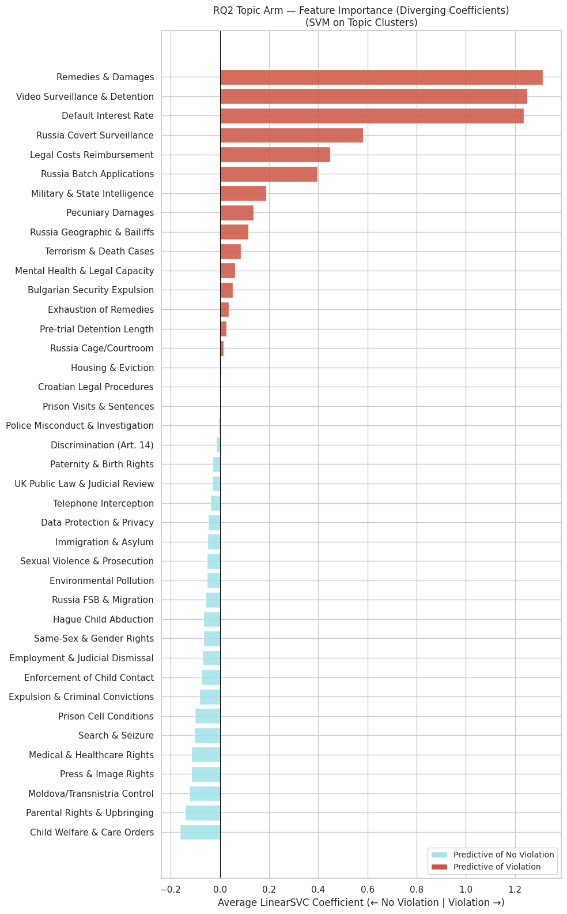
RQ2: Can Topics Predict Outcomes?
Reading Remedy, Not Reasoning
Topics most strongly predicting violation center on damages and compensation, rather than legal tests like proportionality or interference.
Predictive Limits of Themes
For contested topics (e.g. same-sex recognition, data protection) predictive power drops as violation rates approach 50/50.
Topics Outperform Metadata
Despite limitations topic weights (0.857) significantly outperform country and year metadata (0.649).
Notes:
Point 1 — The model is reading the remedy | not the reasoning The topics that most strongly predict violation are about damages and compensation | not about proportionality or interference. The model detects that a violation occurred from financial language written after the decision | not from legal analysis.
Point 2 — Theme alone does not tell you who wins For contested topics like same-sex recognition and data protection | the violation rate is near 50/50. Knowing the theme carries no predictive power there — which is itself a legally meaningful finding about where the Court genuinely deliberates.
Point 3 — Two kinds of predictability Some topics are predictable for the wrong reason (leakage | Russia dominance) | others for the right reason (settled surveillance and detention law). The 0.857 headline figure conflates both — the real performance on genuinely contested legal ground is considerably lower.
Point 4 — Topics still beat metadata Despite the contamination | topic weights (0.857) decisively outperform country and year metadata (0.649). The substantive content of cases carries real signal beyond who the respondent state is.

Slide 23
RQ2: Limitations and Takeaway
Three Structural Limitations
Leakage is structural, not lexical
Cleaning surfaced recurring Article 41 template sentences. Requires removing "just satisfaction" paragraphs entirely before modeling.
Russia distorts the landscape
5 of 40 topics are Russian-specific. Proportional country representation would surface more substantive legal themes.
NMF lacks contextual meaning
Cases like Schalk and Kopf and Breyer share vocabulary but reach opposite outcomes. NMF sees word frequency, not legal reasoning.
Key Takeaway
The topics where there is 50/50 split tells us these are contested areas of law. The fact that the model captures this pattern means it is picking up something real about the legal landscape, not just noise.
Next Step Recommendation
BERT-based topic modelling trained on ECHR-specific text to capture nuanced legal reasoning beyond NMF frequency.
Chalkidis et al. (2019): BERT models pre-trained specifically on ECHR case
Notes:
Because BERT reads words in context rather than just counting them. In the Schalk and Kopf example | the word "family life" appears in both violation and no-violation judgments — NMF cannot tell the difference because it only sees that the word is present. BERT understands that "family life was violated" and "family life falls within the margin of appreciation" are semantically different sentences. For legal text where the same term can justify opposite outcomes | context is everything.
Chalkidis et al. (2019) also developed BERT models pretrained specifically on ECHR case text | so it is not just a generic upgrade — there is a domain-specific version already available that would understand Article 8 vocabulary better than a general-purpose model.

Slide 24
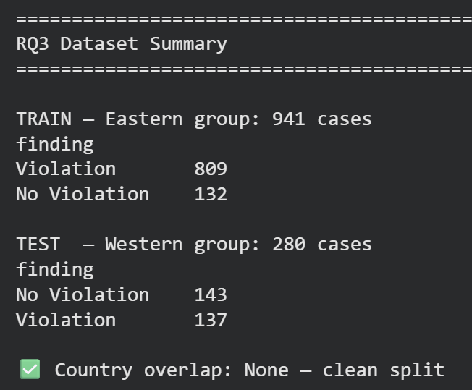

RQ3: Exploring Cross-Regional Generalization
The Motivation
The European Court of Human Rights is not a single monolith. Legal reasoning often diverges across regional boundaries despite a unified framework.
Moving beyond "who is being sued" to "what is the legal reasoning." We aim to decode the semantic patterns that define jurisdictional styles.
Settings
Input: Law_clean
Model: SVM
Output: Findings
For a list of the Western and Eastern European countries | we refer to a list provided by the International Criminal Court.
The Macro F1 Mandate
To avoid "accuracy lies" from class imbalance (982 Violations vs 283 No Violations), we prioritize Macro F1. Unlike weighted metrics, Macro F1 penalizes majority-class bias by averaging outcomes equally holding models accountable for rare "No Violation" retrievals.
Methodology: SVM Interpretability
We utilize Linear SVMs (per Aletras et al., 2016) to move beyond monochromatic predictions. This allows us to extract interpretable weights and identify the specific legal features driving decisions across jurisdictional boundaries.
Notes:
Hello everyone. I’ll be taking you through RQ 3. Up until this point, we’ve looked at the ECHR as if it were a single, unified entity. But in reality, the Court governs different political landscapes.
In our earlier models, we noticed that our algorithms were biased by the respondent country. They were simply learning who was being given a violation, rather than what the legal reasoning was. So, we decided to split the Court into Eastern and Western blocs (with the exception of Turky because it’s not the list but more to come on that). We wanted to ask: Do these regions actually speak the same legal language? Can an Eastern-trained model successfully generalize to the West, and vice versa?
To answer this, we used the Macro F1 score, similar to the previous RQs. We also chose a Linear SVM because it’s easier for interpretation—we actually want to see the words driving the predictions of Violation versus Non Violation.
—---------------------------
Remember the training split—there are over 800 Violations in the East and only 132 No Violations. The Macro F1 treats both outcomes equally, ensuring our model doesn’t artificially inflate its score simply by guessing 'Violation' every single time. We also chose a Linear SVM because it’s easier for two classes interpretation—we actually want to see the words driving the predictions of Violation versus Non Violation.
Finally, RQ1 analysis proved that the "Law" section of the judgments carries a substantially stronger predictive signal than the "Facts" section. So we will used the cleaned version of the law text, instead of full law text, which helps us to actively strip out outcome-leaking vocabulary.

Slide 25
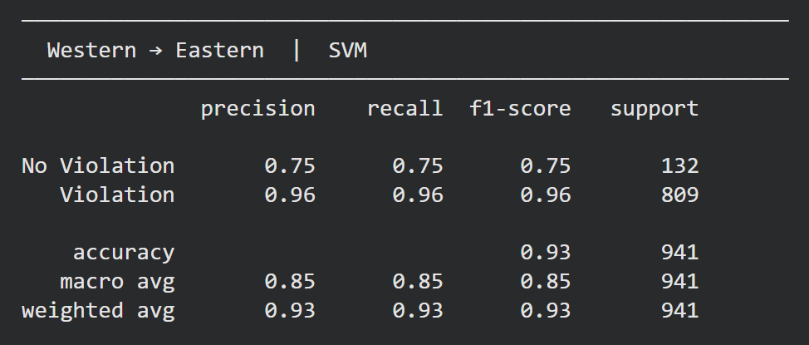
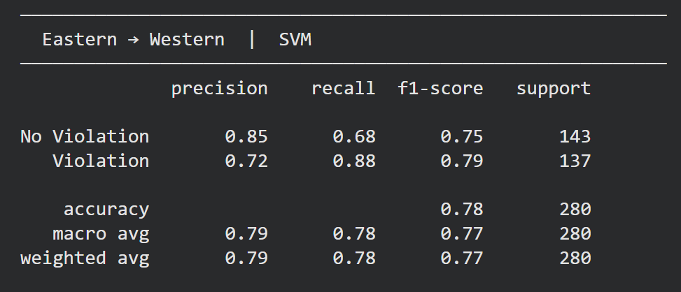
RQ3: Exploring Regional Bias in Generalization
Western → Eastern Generalization
Eastern → Western Generalization
Macro F1
0.85
Macro F1
0.77
Superior robust generalization. Western datasets contain sufficient doctrinal signals to accurately map Eastern outcomes.
Performance degradation. Eastern training creates a more relatively specialized narrowness blind to Western doctrinal nuances.
The Jurisprudential Root Cause
Eastern Europe (Systemic Breaches): Severe physical rights breaches. The algorithm learns a shortcut: state interference = guaranteed violation.
Western Europe (Nuanced Balancing): Focus on administrative disputes, technological privacy and a wider "margin of appreciation."
Conclusion: Eastern models are structurally blind to Western procedural balancing tests, causing aggressive over-prediction of violations.
Notes:
Let's look at the results of our cross-regional experiment. When we put these models to the test, the numbers revealed a clear asymmetry in how well they generalize.
First, look at the left side. When we trained our SVM on Western cases and tested it on the East, it generalized quite effectively, achieving a Macro F1 score of 0.85.
However, looking at the right, when we reversed the direction—training on the Eastern cases and testing on the West—the model struggled, dropping to 0.77.
While those numbers might seem close, the underlying reason for this gap is what really matters.
As we bring you through our analysis, we find that in Eastern Europe, the docket is dominated by severe, systemic, and physical rights breaches. The algorithm typically assumes that any state interference equals a guaranteed violation.
Western Europe, however, is defined by nuanced balancing. The cases there focus heavily on administrative and social topics, and the Court frequently grants Western states a wider 'margin of appreciation.'

Slide 26
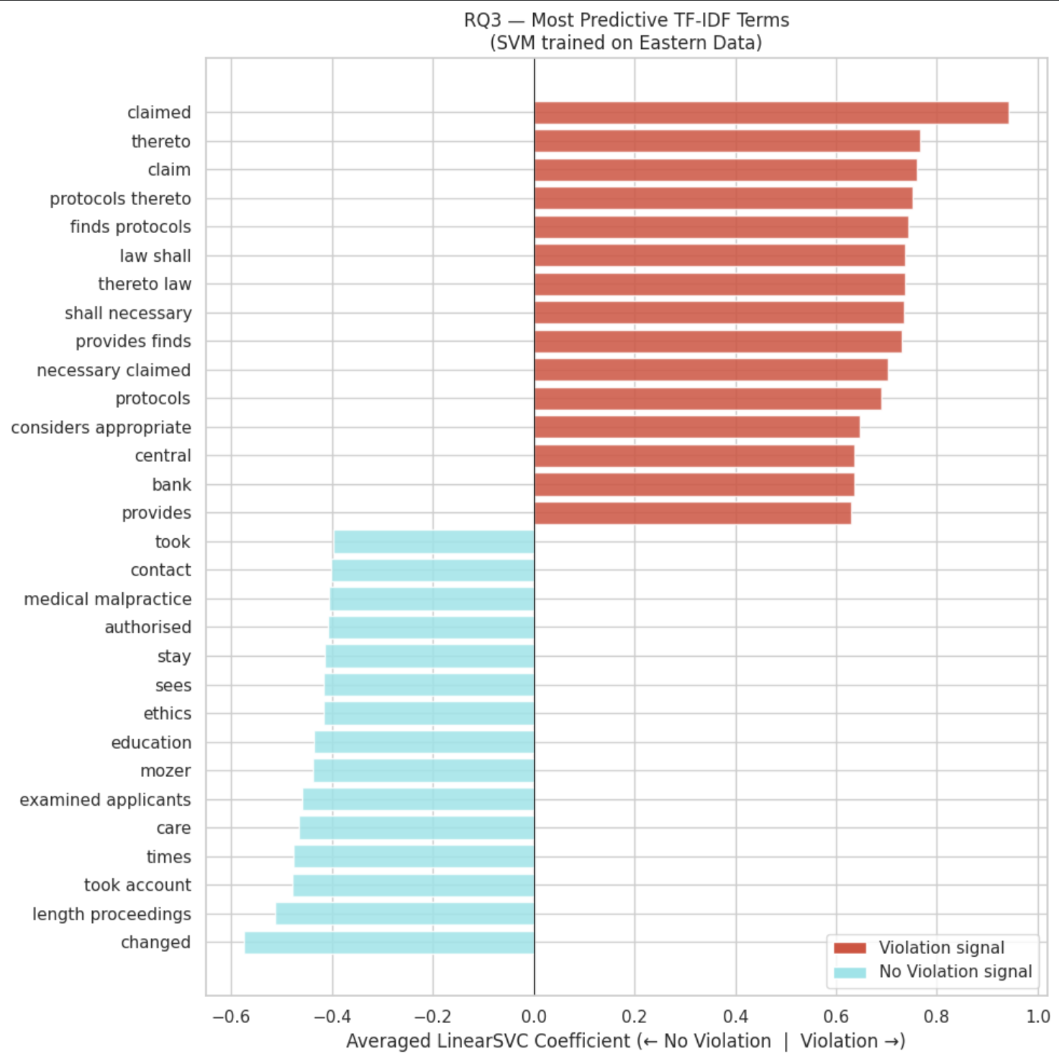
RQ3: Feature Importance (Eastern)
The Violation Signal: Structural Contamination
Models are artificially inflating success by detecting Article 41 "Just Satisfaction" leakage rather than substantive doctrine. The strongest signals for a "Violation" prediction across both regions are procedural boilerplate associated with remedial awards.
Top Contaminant Terms: claimed | finds protocols | thereto law | awards | marginal | central bank.
Eastern "No Violation" Signal
Relies heavily on procedural delays and specific factual scenarios. Features reflect a focus on the length of legal processes rather than complex social balancing.
Key Terms: length proceedings | medical malpractice | education | mozer.
Notes:
Let’s look at feature importance analysis, starting with the East - showing what these models are actually learning to make their predictions—I want to highlight one red flag: structural contamination.
When we looked at the strongest signals predicting a 'Violation' (and you’ll see later for Western as well), the most predictive terms were not about human rights. It was about money. As mentioned previously, our models are artificially inflating their success by detecting Article 41 leakage, which has vocabulary from financial remedies, so you see contaminated terms driving a 'Violation' prediction like 'claimed,' 'awards,' and 'central bank.' It is detecting the remedy, not the legal reasoning.
On the flip side, what more interesting is - what drives an Eastern 'No Violation' prediction? It seems that the 'No Violation' signal relies heavily on procedural delays and highly specific factual scenarios, showing terms like 'length of proceedings,' 'examined applicants,' or 'education.' It is a very rigid signal that lacks the nuanced vocabulary we expect to see when the Court is evaluating justified state interference.

Slide 27
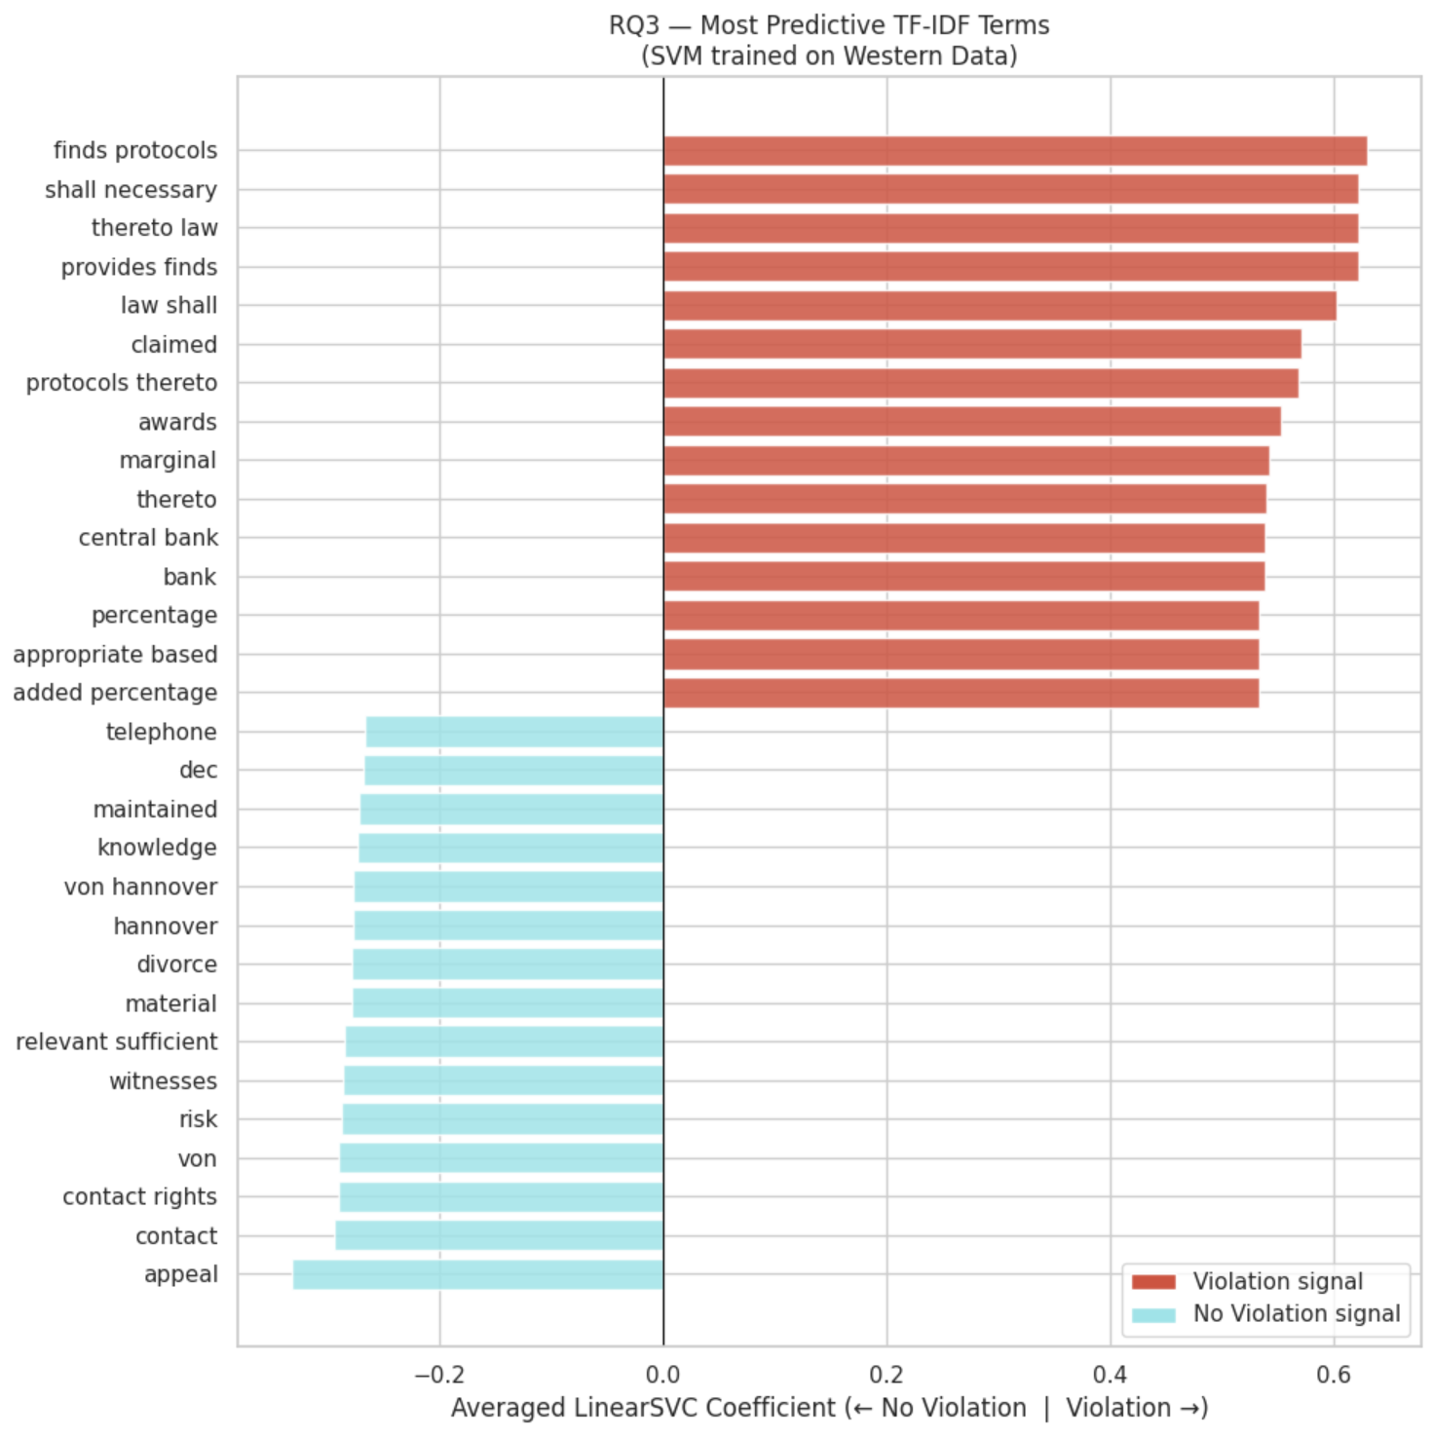


RQ3: Feature Importance (Western)
Western "No Violation" Signal
Captures highly specific social and privacy balancing concepts. Features indicate a deeper engagement with the "margin of appreciation" and landmark privacy cases.
Key Terms: contact rights | divorce | appeal | risk| witnesses | von hannover.
The sharp contrast in "No Violation" vocabulary confirms that factual baselines and legal thresholds for state interference differ fundamentally between regions.
‹#›
Notes:
Now, we shift our focus to the Western model, the picture is the same for violations and there’s contamination, so let’s focus on the non-violations.
When a case is won, it relies on highly specific social and privacy concepts.
The key terms driving a victory here are words like 'contact rights,' 'divorce,' and 'appeal.' The model even catches on landmark privacy precedents, for example picking up the 'von Hannover' cases - these cases were filed by Princess Caroline of Monaco against Germany concerning paparazzi photos of her private life.
And so, this contrast in 'No Violation' vocabulary confirms that the factual baselines and the legal thresholds for state interference differ fundamentally between the two regions.

Slide 28

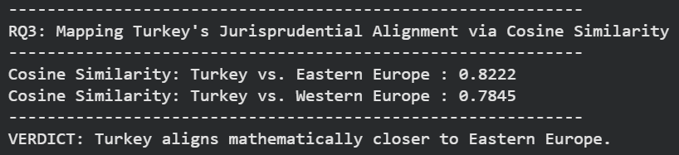
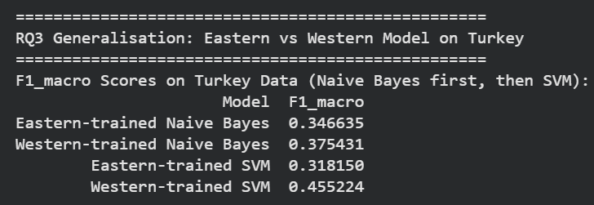
RQ3: The Turkey Anomaly: A Boundary State (Note: Not in ICC List)
Mathematical Alignment
Cosine Similarity (TF-IDF): Turkey aligns closer to Eastern Europe (0.82) than Western Europe (0.78).
Context: Factual vocabulary / scenarios and procedural posture mirror systemic violation patterns of post-Soviet states.
The Predictive Paradox (The Results)
Western-Trained SVM
0.455 Macro F1
Eastern-Trained SVM
0.318 Macro F1
Factual alignment does not equal legal generalization. While Turkey's factual vocabulary is Eastern, its legal complexity demands the broader doctrinal framework and legal boundaries of the Western-trained model for more accurate outcome prediction.
Notes:
To push our theory further on a side quest, we decided to isolate cases from Turkey as a 'boundary state' to see how our models would handle it.
If we look purely at the math—specifically the vocabulary overlap using cosine similarity—Turkey aligns much closer to Eastern Europe. And this makes sense. Its factual scenarios closely mirror the structural violation patterns we see in post-Soviet states. So on paper, Turkey looks Eastern.
But here is where we hit a fascinating predictive paradox. Despite sharing similarities with Eastern facts, our Western-trained model predicted the Turkish outcomes better than the Eastern model did - as you can see it scored 0.455 on Macro F1.
So, why is this the case? Probably needs more deeper analysis, but our hypothesis is that factual alignment does not equal legal generalization, especially for edge cases like Turkey.
Turkey might share the factual vocabulary of the East, but to accurately separate a justified state action from a true human rights violation, the model needs a broader doctrinal framework, which the Western model gives.

Slide 29
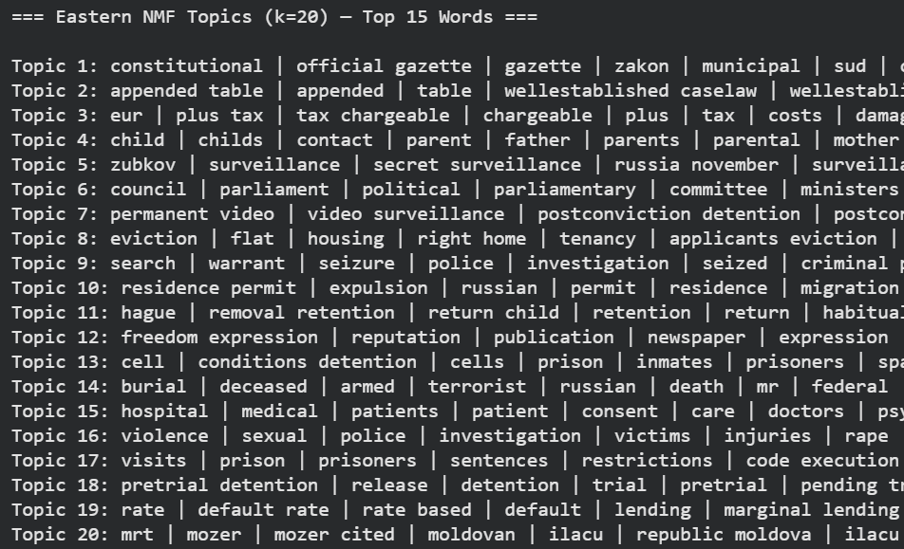
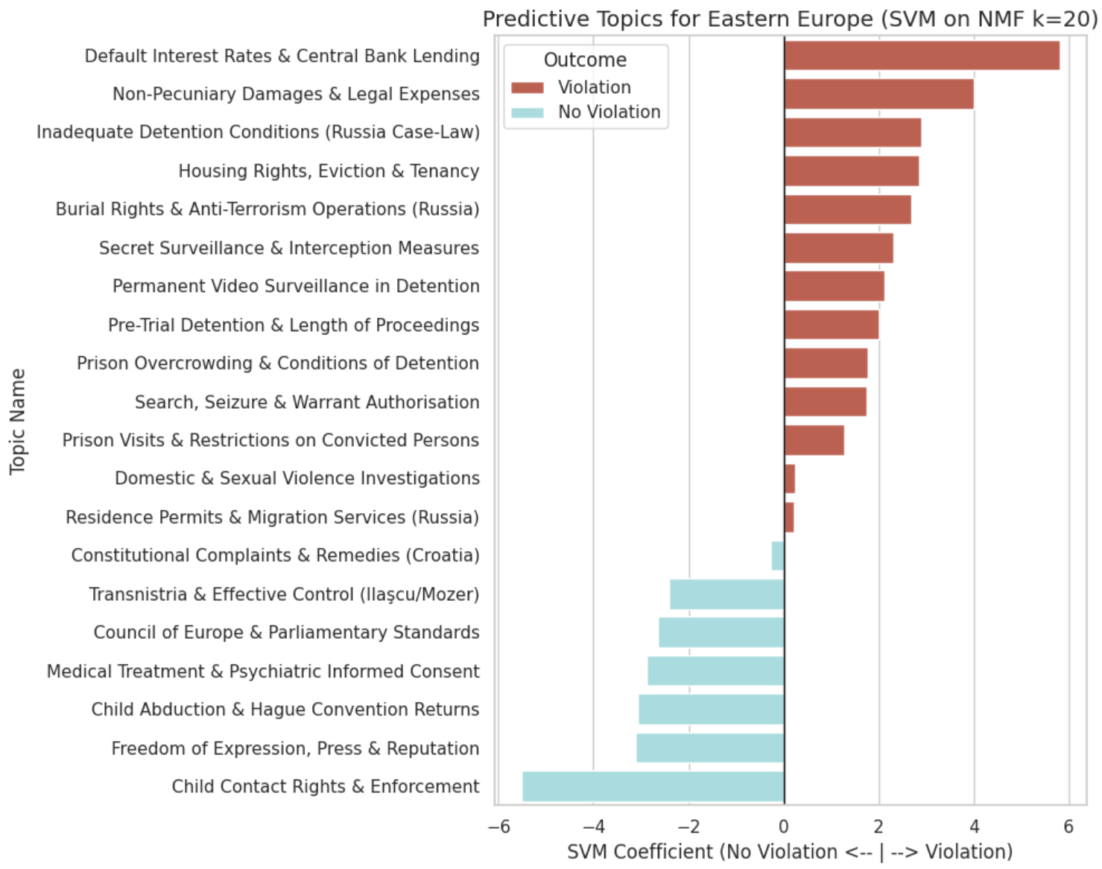
RQ3: Feature Importance and Topic Weights Analysis (Eastern)
To understand the semantic divergence, we trained separate Linear SVM classifiers on 20 NMF-generated topic features. The coefficients reveal stark differences in the types of cases driving findings in each bloc.
Eastern Europe: Systemic Failures vs. Family Disputes
The Eastern European model reveals a jurisprudence heavily weighted by structural and physical state interference.
PREDICTIVE OF VIOLATION
PREDICTIVE OF NO VIOLATION
Systemic & Physical Breaches: Characterized by severe rights violations
State Surveillance: "Zubkov | Armed | secret surveillance"
Detention: "Cell | conditions detention | Permanent video"
Lethal State Action: "Burial | deceased | armed | terrorist"
Private Family Matters: Center of "No Violation" predictors
Child Custody: "Child | contact | parent" and "Hague | removal retention"
Margin of Appreciation: Domestic authorities frequently found to operate within legal bounds in custody disputes.
Notes:
Now back to the main mission - we decided to look into why these models predict differently, and extract the underlying legal topics.
What is the meaning of the vocabulary driving these decisions?
When we look at the Eastern model, the vocabulary driving a 'Violation' prediction centers on systemic and physical state interference, highlighted by words related to 'state surveillance,' 'detention,' and even 'lethal state action.' This tells us that in the Eastern docket, a human rights violation is typically a severe, physical breach by the state apparatus itself.
So then, what drives a 'No Violation' prediction?
The answer is largely confined to private family topics, such as child custody and family contact disputes. What this tells us is that for private disputes between citizens, the Court frequently grants them a wide margin of appreciation.
The model has learned a specific reality about Eastern Europe: if the state itself is taking direct action—like through police or prisons—it's almost certainly a violation. And when it involves private family disputes, it’s likely a win for the case.

Slide 30
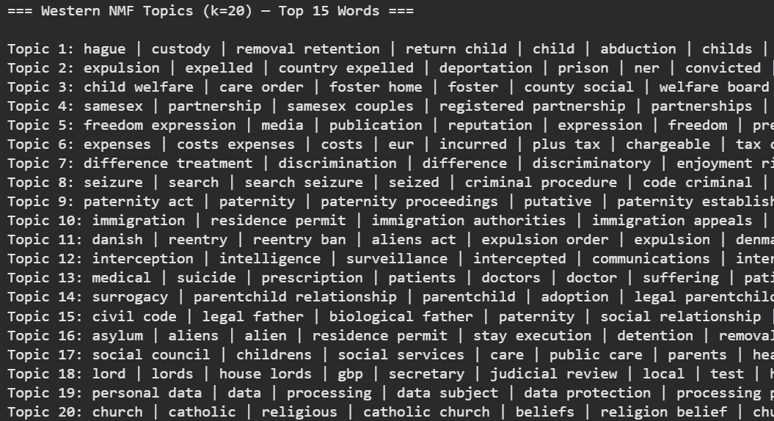
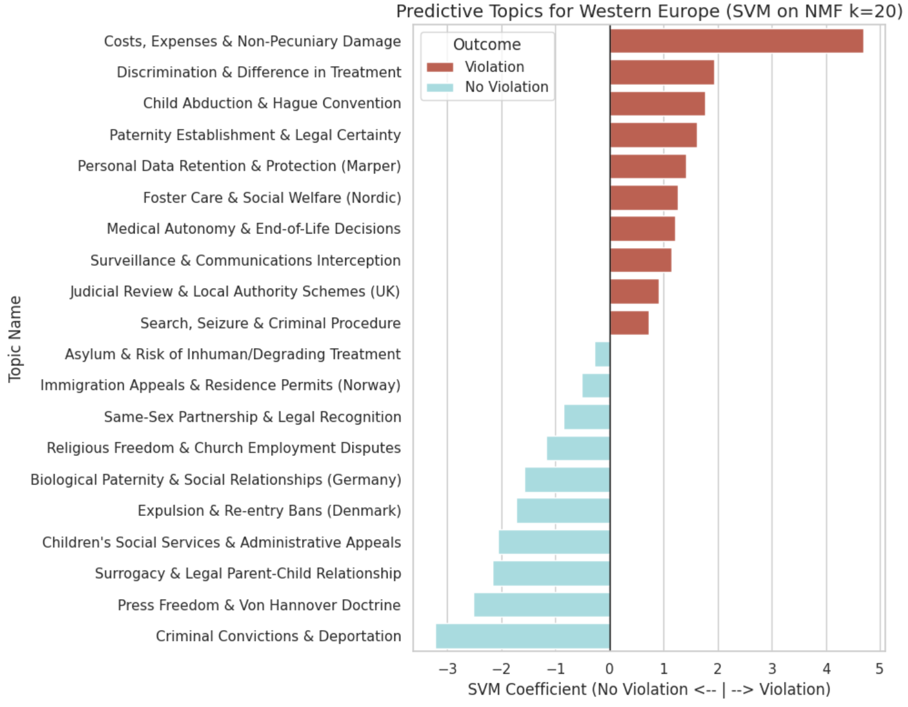
RQ3: Feature Importance and Topic Weights Analysis (Western)
To understand the semantic divergence, we trained separate Linear SVM classifiers on 20 NMF-generated topic features. The coefficients reveal stark differences in the types of cases driving findings in each bloc.
Western Europe: Nuanced Rights vs. Migration Margin
The Western European model maps a vastly different legal landscape, focused on administrative, technological and evolving social rights.
PREDICTIVE OF VIOLATION
PREDICTIVE OF NO VIOLATION
Administrative Precision: Specific focus on "data protection | processing | personal data."
Procedural Issues: Topics like "paternity act | putative" and "difference treatment | discrimination."
Hague Convention: "hague | custody | removal retention" is a strong violation predictor | contrasting with Eastern.
Migration & Deportation: States granted wide margin in "expulsion | deportation" and "asylum | aliens."
Social Signals: Evolving issues like "same sex | partnership" | "surrogacy | adoption" | “freedom”.
Margin of Appreciation: Non-violation boundaries are defined by areas of high sovereign discretion.
The analysis confirms a fundamental divergence in the "factual matrix" of human rights. Eastern topics focus on power dynamics, while Western topics reflect procedural balancing of administrative, social and technological rights.
Notes:
Now, we look at the Western European model, which shows a totally different legal reality.
First, what drives a 'Violation' in the West? If we set aside the financial leakage at the top, the vocabulary of a Western violation is highly administrative. The model flags words related to 'data protection,' 'paternity,' and 'discrimination.'
Then let’s look at the 'No Violation' boundary.
The strongest predictors that a state will win involve complex migration issues, words including 'asylum,' 'expulsion,' and 'residence.' It also heavily features modern, evolving social issues that lack a clear consensus, like 'same-sex partnerships' and 'surrogacy.'
From here we can see that the Western model isn't looking for physical breaches and police action; it is analyzing complex social balancing.
This analysis confirms a fundamental divergence in the 'factual matrix' of human rights between the two regions. Eastern topics focus heavily on power dynamics and physical state interference, while Western topics reflect the nuanced balancing of social and administrative rights.
—-------------------------------
Interestingly, topics involving 'Hague Convention' disputes strongly predict violations here, which is the exact opposite of how the Eastern model treats them.
Hague Convention on International Child Abduction does not necessarily predict fewer violations in Eastern Europe compared to Western Europe; rather, the perceived higher rates of violations in some Western European nations stem from complex legal, procedural, and social factors within the EU legal framework, especially when it involves children, and abduction.

Slide 31


RQ3: Acknowledging Limitations & Next Steps
1. "Just Satisfaction" Leakage
2. Hyperparameter Rigidity (k=20)
3. Static Word Representation
The Issue: Predictors often rely on financial remedy boilerplate (damages, costs) rather than law.
The Impact: Artificially inflates success by spotting retroactive Article 41 language.
The Fix: Explicitly excise "just satisfaction" paragraphs prior to fitting.
The Issue: "Bag-of-Words" NMF groups co-occurring terms but ignores syntax.
The Impact: Cannot detect *how* a word is used (e.g. changing applications of "margin of appreciation").
The Issue: Constrained NMF to exactly 20 topics for cross-regional stability.
The Trade-off: Prevents splintering but risks "topic collapsing"—mashing distinct concepts together. Nonetheless, we We trained regional Linear SVMs on extracted topic weights to test if these 20 thematic markers are sufficient for prediction. Confusion matrices confirm that these topics provide a robust signal for native jurisprudence.
TRANSITION TO RQ4
Necessitates moving beyond static topics to explore semantic neighborhoods using Word2Vec.
The Verdict:
Western-trained models generalise effectively because they have learned a more broadly applicable doctrinal framework. Eastern-trained models fail to generalise as they learned a specific pattern of state interference that does not transfer to the proportionality-centred reasoning characteristic of Western jurisprudence.
A genuinely portable Article 8 classifier would require a balanced geographically diverse training corpus with Article 41 text removed prior to feature extraction.
East → West
0.77 Macro F1
West → East
0.85 Macro F1
Notes:
To answer the question: Generalization is asymmetric. Western-trained models generalize effectively because they learn a broader doctrinal framework. Eastern models fail because they learn a specific pattern of physical state interference that doesn't transfer as well to the nuanced balancing of the West.
We also want to acknowledge three critical limitations in our analysis:.
First, Article 41 Leakage. As we said, the algorithm learned to spot 'Just Satisfaction' damages, which artificially inflated our accuracy. If we get a chance to do this analysis again in the future (hopefully not), any future models must explicitly delete this text.
Second, to maintain stability across regions, we locked our topic modeling to exactly 20 topics, which presents a potential risk of mashing distinct legal concepts together, even though we do feel that 20 topics are sufficient for robust signalling at this point and we did have additional analysis on this by confusion matrices which proved that but that’s in the modelling analysis.
Third, and most importantly, our models are using 'bag-of-words’ approaches. They know a word exists, but they don't understand syntax. A static model can see the words 'margin of appreciation,' but it cannot detect how the Court is applying that phrase in a sentence.
To truly understand how the meaning of these concepts shifts across borders, I will hand it off to Rini for our RQ4 analysis and exploration. Thank you.

Slide 32

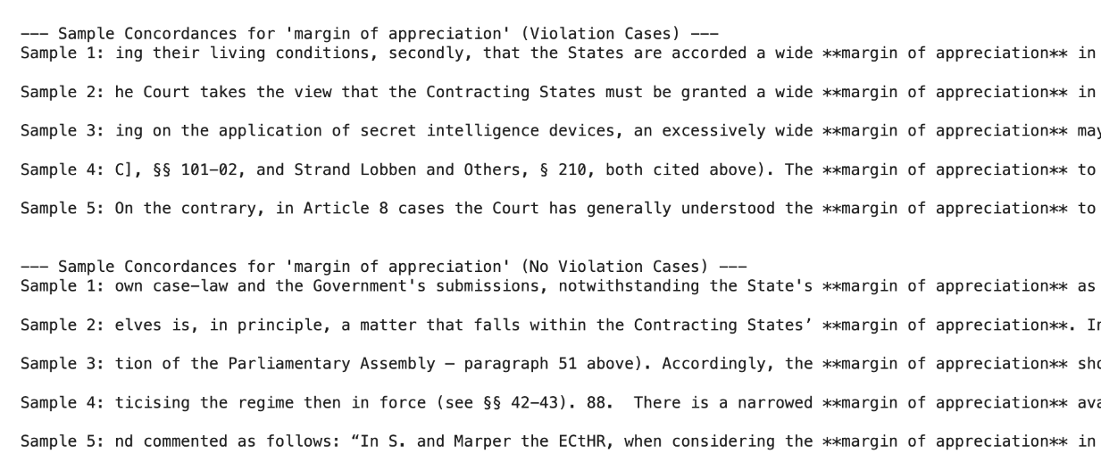
RQ4: Detecting Semantic Drift in East v. West
Why model trained on Eastern and Western corpus perform differently ?
Is there any legal concepts that is practiced differently between these two regions ?
Method from (Hamilton, 2016) :
Separate Word2Vec models trained on East/West corpora
Calculate global (dG) and local (dL) semantic drift.
Neighborhoods mapped via t-SNE.
Hypothesis:
If these doctrinal terms carry different semantic weight across regions, that would explain why a classifier trained on one region struggles to generalise to the other
NECESSARY
MARGIN
MARGIN APPRECIATION
PRIVATE LIFE
FAMILY LIFE
POSITIVE OBLIGATION
CORRESPONDENCE
PROPORTIONATE
DEMOCRATIC
SECURITY
SAFETY
HOME
Result from concordances in EDA
Notes:
Now we move to our final research question: Why do models trained on Eastern and Western corpora perform so differently? We hypothesized that shared doctrinal terms might actually carry different semantic weights across these regions. To test this, we used Word2Vec to map the 'semantic neighborhoods' of focal terms like 'necessary,' 'margin,' and 'family life'. While surface-level terms are identical, their context reveals a deep regional divergence."

Slide 33
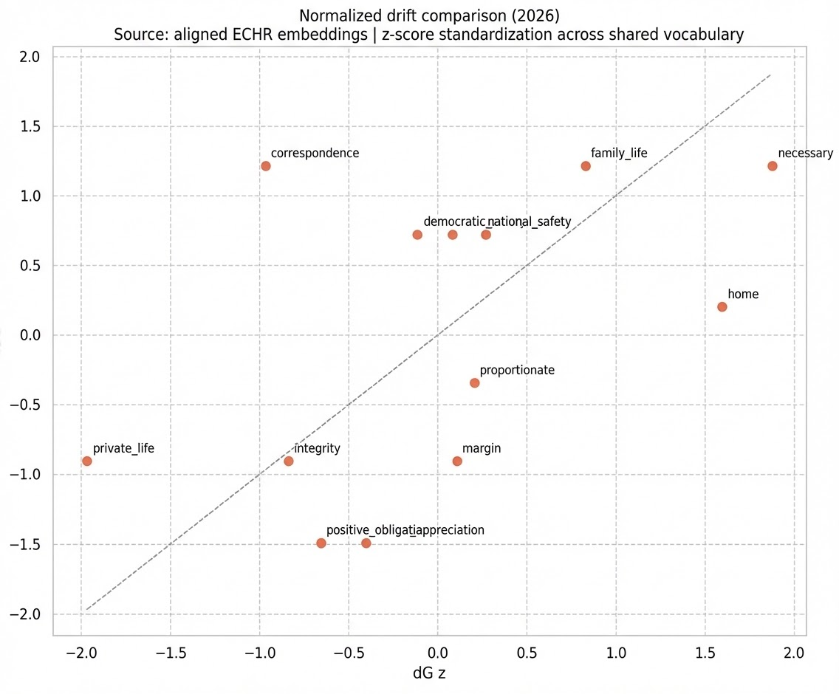
RQ4: Semantic Drift in FOCAL terms
dG measures global semantic displacement
dL measures local neighbourhood change
Above avg dLz
Below avg dG z
Above avg dL z
Above avg dG z
Below avg dL z
Below avg dG z
Below avg dL z
Above avg dG z
Some concepts shift mainly in their regional context, but the core doctrinal terms still remain semantically recognizable across both corpora
Notes:
This visualization shows the normalized drift comparison between the two aligned ECHR embeddings. We measured 'dG' for global semantic displacement and 'dL' for local neighborhood changes. You can see that terms like 'correspondence,' 'family life,' and 'necessary' exhibit significant shifts. This proves that while core doctrinal terms remain semantically recognizable, they are functionally shifting in their regional application."

Slide 34
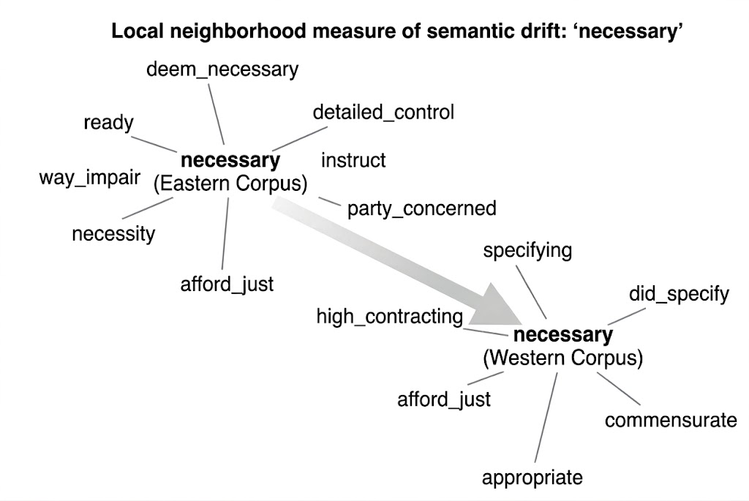
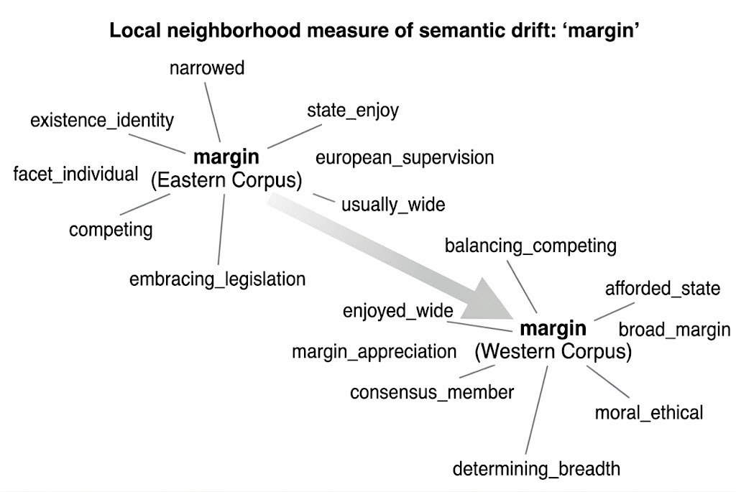
RQ4: Drift Interpretation - Doctrine
dL z
dL z
dG z
dG z
NECESSARY
East: appears near threshold and gatekeeping language , to consider whether an action clears the minimum bar to be considered necessary at all.
West: embedded in a detailed compliance and proportionality assessment, not whether the threshold is met, but how precisely the state justified each specific step it took.
MARGIN
East: appears near concepts of individual identity and competing interests being weighed, suggesting use margin of appreciation in the context of whether the state encroached on personal autonomy at all.
West: is more about supervisory framework, considers how wide the margin is, what factors determine its breadth, and what European consensus says about it.
Notes:
Looking at specific doctrinal shifts, the term 'Necessary' in the East appears near gatekeeping language, focusing on whether an action clears the minimum bar to be considered necessary at all. In the West, it is embedded in detailed compliance and proportionality assessments. Similarly, the 'Margin' of appreciation in the East is about whether the state encroached on personal autonomy at all, whereas in the West, it acts as a procedural shield to validate domestic consensus and legislative finality

Slide 35
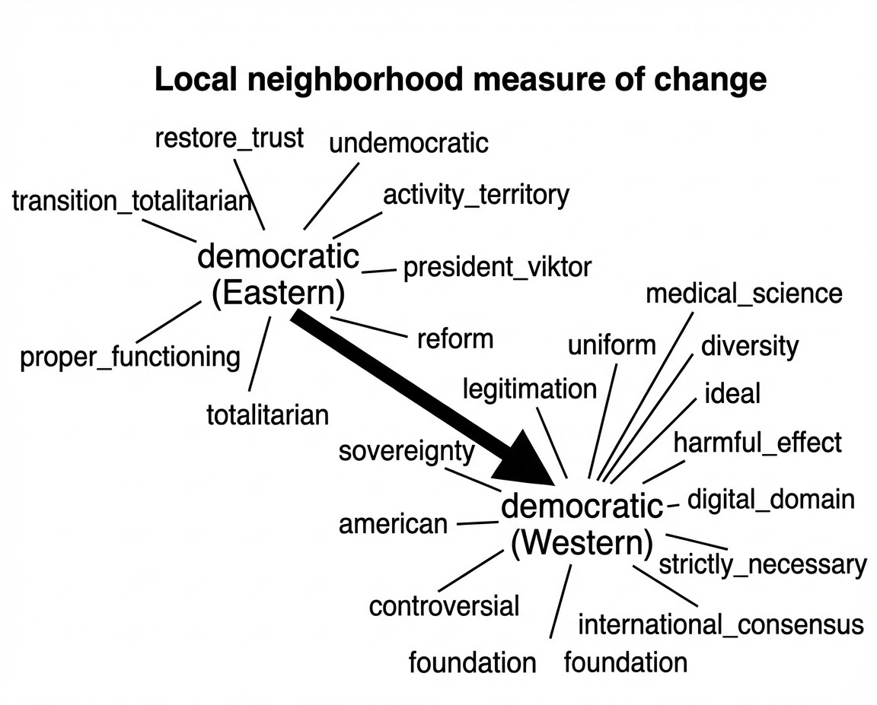
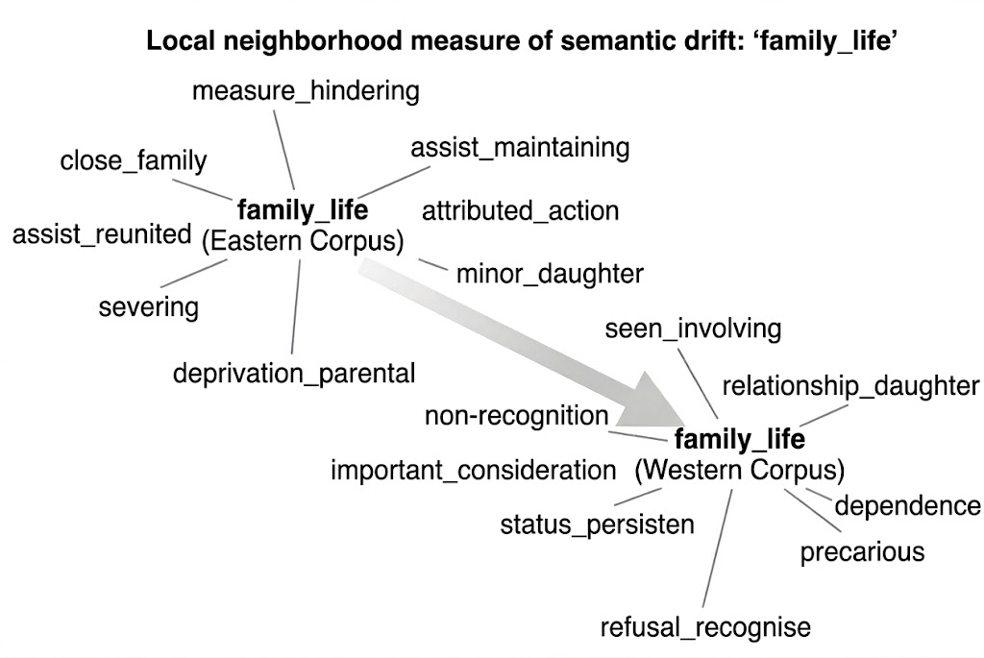
RQ4: Drift Interpretation - Intangible
dL z
dL z
dG z
dG z
DEMOCRATIC
East: democratic describes what the state should become, words associate with states still transitioning away from authoritarian governance.
West: appears to be a legal threshold, "necessary in a democratic society" as a procedural standard the state must clear to justify interference under Article 8(2).
FAMILY LIFE
East: about physical family separation, the state removing children, severing parental bonds, preventing reunion.
West : about legal status and recognition, whether relationships are formally acknowledged by the state rather than physically disrupted by it.
Notes:
For intangible concepts, 'Democratic' in the East is aspirational, describing what the state should become as it transitions from authoritarianism. In the West, it is an institutional baseline standard. 'Family Life' also drifts: in the East, it centers on the physical disruption of parental bonds, while in the West, the legal battle has moved toward the formal recognition of migrant and non-traditional family structures."

Slide 36
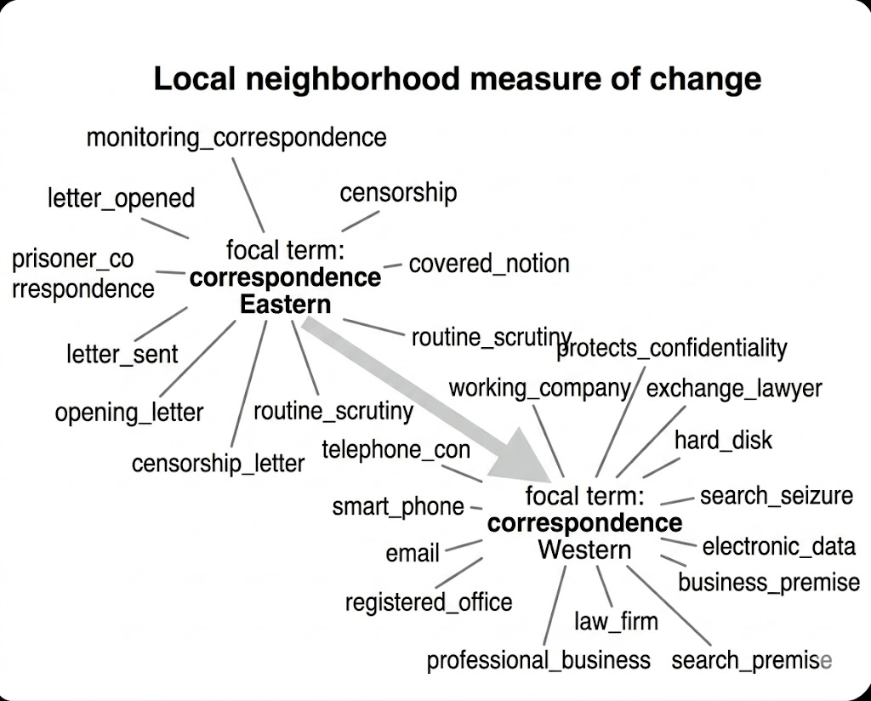
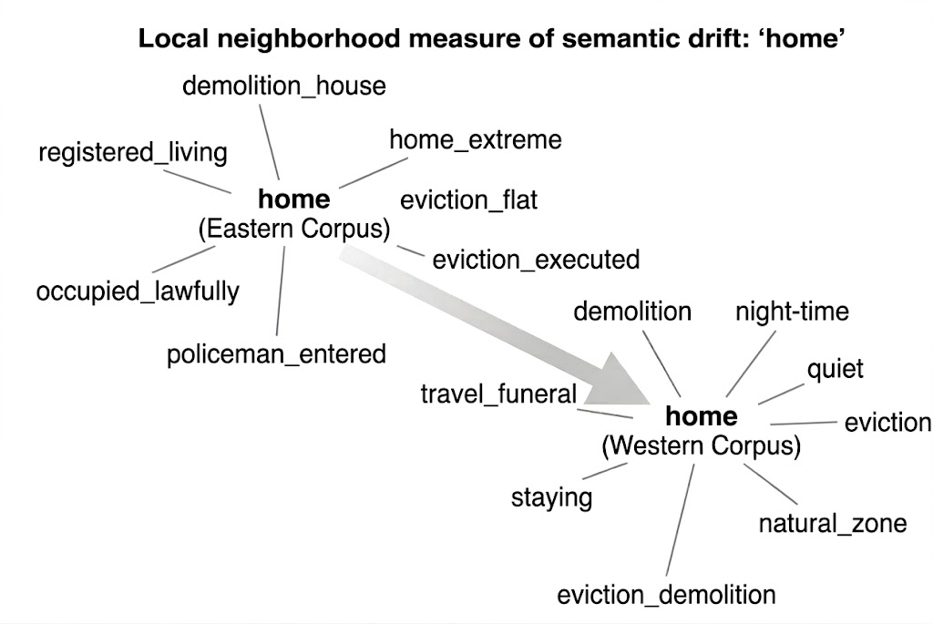
RQ4: Drift Interpretation - Tangible
dL z
dL z
dG z
dG z
CORRESPONDENCE
East : about physical prison mail, the state opening, reading, and censoring letters sent by detainees. Reflecting a primary focus on the state’s surveillance of individuals in detention.
Western : shifted into digital and professional life domains,, emails, business communications, lawyer-client privilege, and electronic data seized during premises searches.
HOME
East : about forced physical removal, bailiffs executing eviction orders, police entering premises, demolition of dwellings. The state interference is direct and often violent.
West : retains eviction language but shifts toward quieter enjoyment rights, noise, planning restrictions, natural zones, and the right to remain undisturbed in one's dwelling rather than forcible removal.
Notes:
"Our most tangible terms show the clearest divide. 'Correspondence' in the East is a physical object—a prisoner’s letter subject to state censorship. In the West, it is digital data and business communications. Likewise, 'Home' in the East is a precarious status defined by physical survival and the threat of forced eviction, while in the West, it has evolved into a functional space defined by environmental standards and the right to quiet enjoyment.

Slide 37
Focal Term | Eastern Focus (Foundational / Aspirational) | Western Focus (Sophisticated / Institutional)
Democracy | Aspirational: Describes what the state should become. | Institutional: Describes the legal standard the state must meet.
Home | Physical Survival: A precarious legal status defined by the threat of displacement and eviction. | Quality of Life: A functional space defined by environmental standards and privacy.
Margin | Existential Gatekeeping: Used to determine if the state encroached on personal autonomy at all. | Procedural Shield: Used to validate domestic consensus and justify legislative finality.
Necessary | Threshold Test: Gatekeeping language to see if an action clears the minimum bar for necessity. | Proportionality Test: Embedded in detailed compliance assessments of how the state justified each step.
Family Life | Legal & Biological: An essential institution the state must not disrupt without high proof. | Factual Reality: A social reality the state is asked to recognize, often in migration contexts.
Correspondence | Physical Object: Subject to direct state censorship, primarily within prison systems. | Digital Data: Integrated into professional life and workplace privacy boundaries.
Notes:
"To conclude this section, this table summarizes the foundational vs. sophisticated divide. In the East, Article 8 is a tool for restoration and defense against direct state interference. In the West, it is a tool for management and inclusion, assumes stability, and litigates the sophistication of safeguards. This semantic drift explains why a model trained on Eastern systemic failures cannot generalize to Western procedural balancing.

Slide 38

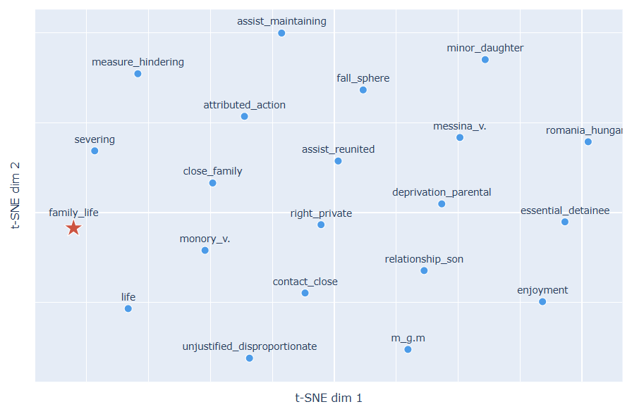
RQ4 : Limitations
Noise Words & Interpretation
Imbalance dataset and decision not to use NER in BoW cause t-SNE visualization will contain several noise words. On top of interpreting the chart, removing noise words will require needs manual effort and certain level of legal sense.
BERT for Future Work
Implementing BERT for Word Embeddings will solve the limitation. Especially with specific ECHR-pretrained model available in Hugging Face.
?
The Verdict:
There is evidence that systematic semantic drift in the use of key Article 8 concepts across the two regional corpora, and it might contributes to the model's inability to generalise across jurisdictional boundaries. To justify the claim, we need to apply contextual embedding technique to the same doctrinal terms.
Notes:
Naturally, this method has limitations. Imbalanced datasets and noise words in BoW models require significant manual effort to interpret. For future work, we recommend implementing LEGAL-BERT. This pre-trained model for the legal domain captures the context-sensitive nuances that static embeddings miss. Using contextual embeddings will be essential to truly justify claims about how specific word placements alter legal outcomes.

Slide 39

Conclusion
The Limits of Universalism
AI models cannot be universal: a model trained on Eastern systemic state failures cannot generalize to Western proportionality balancing. Shared terminology creates an illusion of alignment.
Performative Syntax
Accuracy depends on contextual reading. Occasional close reading is necessary because outcome often depends on the logical arrangement of words rather than the words themselves
Technical & Methodological Limitation
Article 41 Structural Leakage and other article mixed in as well
Training Data Bias : dominated by Russia + violation, also contain semantic drift between East & West.
Skill & Computation Power : we set our boundaries by using technique feasible for CPU
Future Directions
Reasoning: Transition to BERT-base-uncased-echr for sentence-level legal reasoning.
Corpus: More balanced training set to address dominant case and leakage article and words.
Philosophical Framing
As Heidegger notes, technology reveals what's already exist but also alters how we see it; The algorithm exposes the geographic epistemology embedded in law, and we apply different technique to find the why.
To build legal AI is to encode the socio-political history of a region; "neutral" law is a mathematical impossibility.
Notes:
. The Limits of Universalism
Contextual Divergence: AI models demonstrate that there is no "universal" application of Article 8. A model trained on Eastern systemic state failures (such as direct physical interference) cannot generalize to Western proportionality balancing.
The Illusion of Alignment: While the East and West share the same legal terminology, the "semantic drift" analysis proves that these words function differently across borders. Shared vocabulary creates a false sense of a unified legal framework when the actual battlegrounds are regionally distinct.
2. Technical & Methodological Limitations
Structural Leakage (Article 41): Models often achieve high accuracy not by understanding law, but by detecting "leakage". Specifically, they identify boilerplate remedy language from Article 41 (just satisfaction) that only appears in violation judgments.
Geographic Bias: The dataset is heavily dominated by Russia (27% of cases) with a 93.6% violation rate. This causes models to learn geographic "shortcuts" (e.g., Russia = Violation) rather than transferable legal reasoning.
Computational Constraints: The research boundaries were set by using techniques feasible for standard CPU processing, which limited the use of more complex, power-intensive deep learning models.
3. Philosophical Framing: Performative Syntax
Arrangement over Vocabulary: Accuracy in legal AI depends on contextual reading rather than simple word matching. Because the vocabulary of "No Violation" mirrors that of "Violation," the outcome often depends on the logical arrangement of words rather than the words themselves.
The "Why" behind the Law: Occasional close reading remains necessary because static models cannot yet capture the "performative" nature of how judges use identical words to justify opposite results.
4. Future Directions
Transition to Contextual Embeddings: To solve the "Bag-of-Words" limitation, future work must use LEGAL-BERT (specifically models pre-trained on ECHR text) to capture sentence-level legal reasoning.
Corpus Refinement: Future models require a more geographically balanced training set. This would address the dominance of specific countries and allow for the paragraph-level excision of remedy sections (Article 41) to ensure the model is learning substantive law.
5. Philosophical Conclusion: Geographic Epistemology
Technology as a Revealer: As noted through a Heideggerian lens, technology reveals existing patterns but also alters how we perceive them. The algorithm exposes a geographic epistemology—a way of knowing and applying law that is fundamentally tied to a region's history.
Neutrality is Impossible: Ultimately, building legal AI is an exercise in encoding the socio-political history of a region. The research concludes that a truly "neutral" law is a mathematical impossibility; the AI will always reflect the battlegrounds of the data it consumes.

Slide 40


